Slide 1

Search for an exotic Higgs boson decay to two pseudoscalar bosons with a four photon final state Oral Candidacy Proposal December 13, 2023
Sergi Castells
Advisors: Colin Jessop and Nancy Marinelli

Slide 2
The Standard Model and Beyond
LHC, CMS, Technical Contributions
Introduction to Analysis
Sample Generation
Event Selection
Signal Modelling
Advancements on Previous Studies
Summary
Notes:
Introduction – what am I doing? Basic why is it interesting?
The Standard Model and Beyond – theory stuff
LHC and CMS – also mention service work here briefly
Sample Generation – signal MC and event mixing part
Event Selection – cuts, BDT, categorization
Signal Modelling – signal modelling + note on background fits
Advancements on Previous Studies – exactly what it sounds like
Summary – put everything together for questions
REMEMBER TO INCLUDE PLOTS!!!!!!!

Slide 3
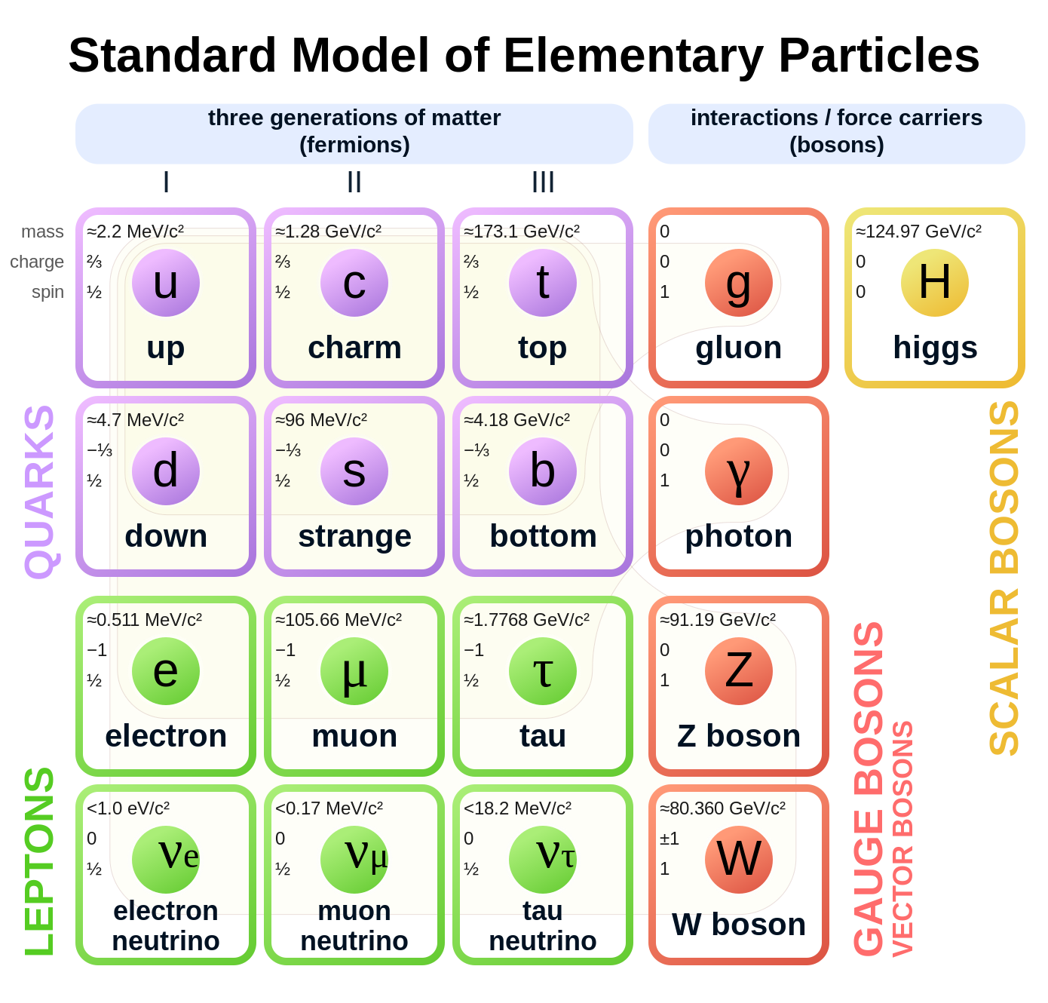
The Standard Model
Most complete model of particle physics that describes all known elementary particles.
Describes three fundamental interactions:
Weak
Strong
Electromagnetic
Rich Higgs sector phenomenology:
Higgs mechanism yields gauge boson masses
Higgs vacuum expectation value & Yukawa couplings yield other particle masses excluding neutrinos
Notes:
shortcomings: hierarchy problem, neutrino masses, dark matter
SM has SU(3)_C x SU(2)_L x U(1)_Y internal symmetry

Slide 4
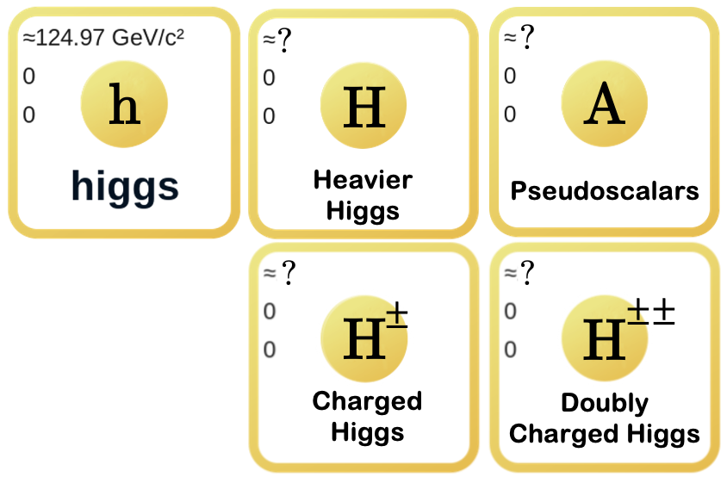
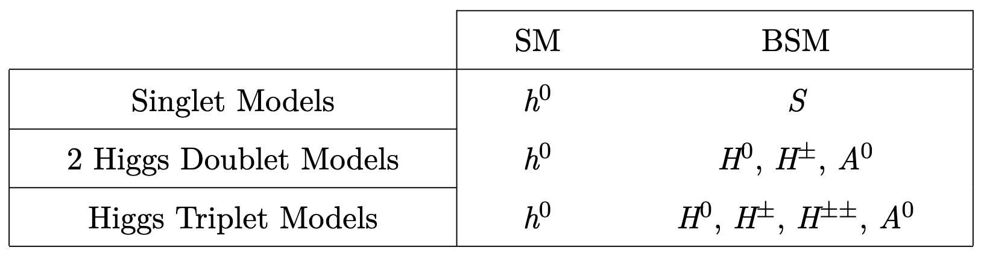
Beyond the Standard Model
Beyond the Standard Model physics can remedy its shortcomings and predict interesting, new physics.
New phenomenologies are introduced that can be checked experimentally!
Many models introduce an extended Higgs sector.
Can remedy hierarchy problem, dark matter, and more.
New matter content of common models:
Notes:
New physics means more particles, e.g., pseudoscalar bosons.
”And more” can refer to additional sources of CP-violation. Higgs could be a pseudo-Goldstone boson from a greater gauge group, which would explain the low mass. There could also be an answer to unified gauge coupling there.
Note that hierarchy problem is related to the EW scale (Higgs VEV) being so small relative to Planck scale NOT the Higgs mass. Large corrections are needed to keep the Higgs mass low where it is… Fine tuning problem
I’m looking for pseudoscalar bosons (CP-odd, e.g., imaginary bottom half of Higgs doublet). Many models predict pseudoscalars and leave a large phase space to be explored.

Slide 5
The Standard Model and Beyond
LHC, CMS, Technical Contributions
Introduction to Analysis
Sample Generation
Event Selection
Signal Modelling
Advancements on Previous Studies
Summary
Notes:
Introduction – what am I doing? Basic why is it interesting?
The Standard Model and Beyond – theory stuff
LHC and CMS – also mention service work here briefly
Sample Generation – signal MC and event mixing part
Event Selection – cuts, BDT, categorization
Signal Modelling – signal modelling + note on background fits
Advancements on Previous Studies – exactly what it sounds like
Summary – put everything together for questions

Slide 6
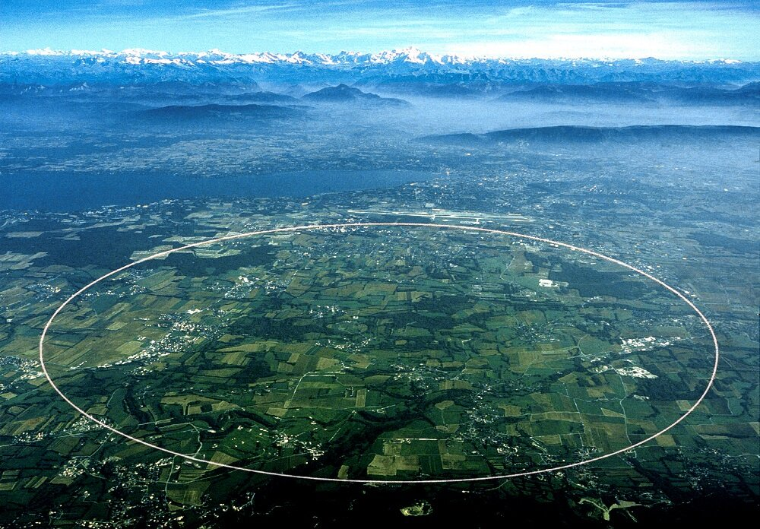
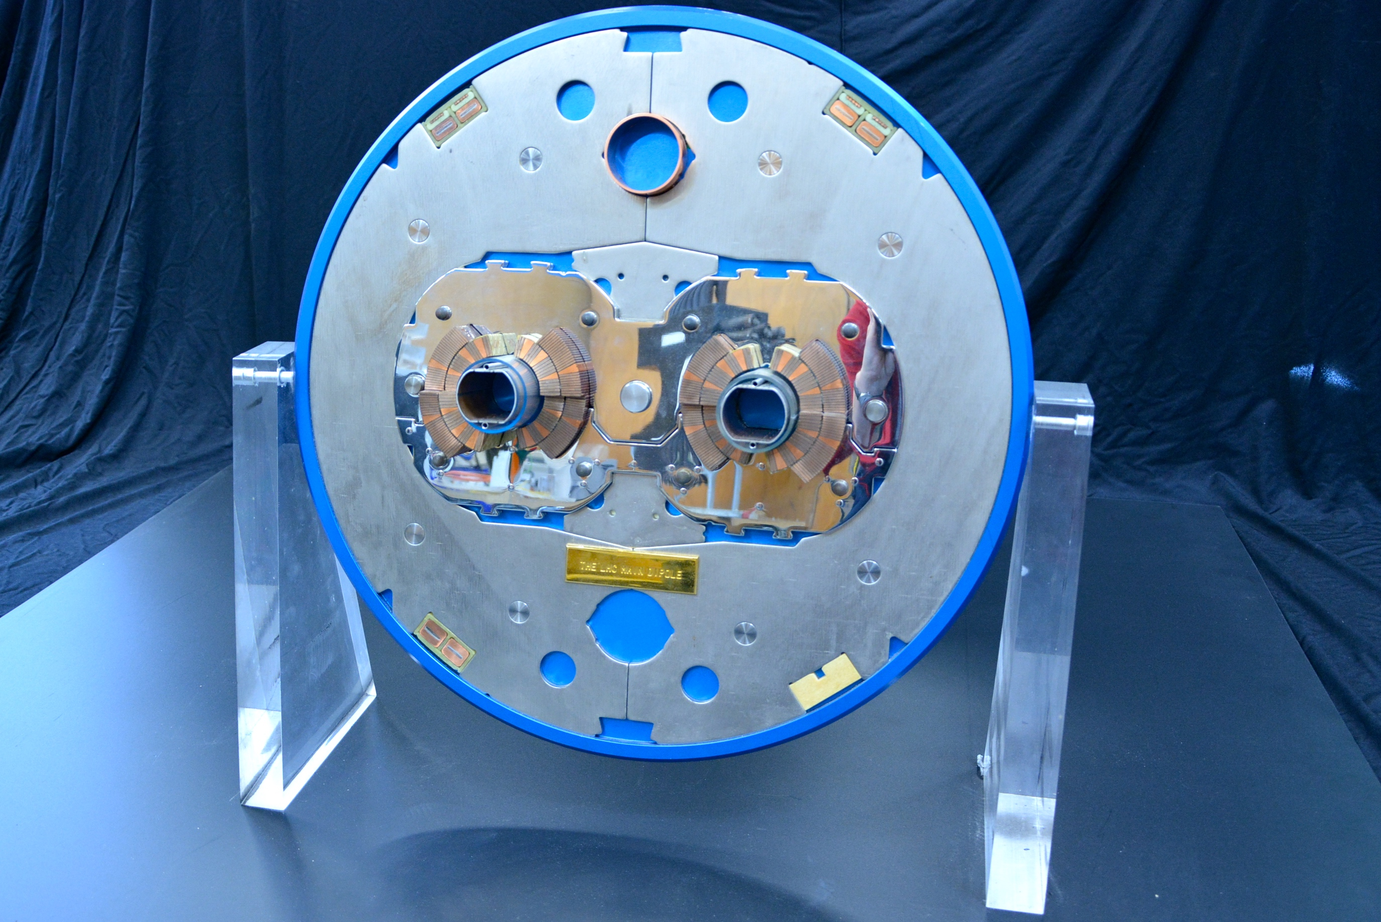
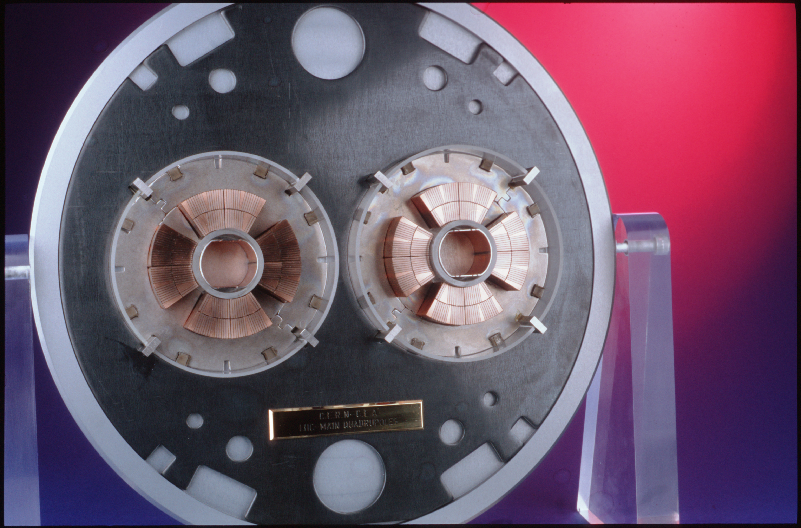
The Large Hadron Collider (LHC)
The LHC is the world’s largest particle accelerator, located on the border of France and Switzerland.
It is 27 km in circumference and operates at a center-of-mass energy of 13.6 TeV.
The LHC can achieve a nominal instantaneous luminosity of 10³³ cm⁻² s⁻¹, colliding proton beams at a frequency of 40 MHz.
Superconducting dipole and quadrupole magnets bend and squeeze the proton beams, respectively.
Four detectors along beamline:
General purpose: CMS and ATLAS
Specialized: ALICE and LHCb
Above: Slice of LHC dipole magnets.
Below: Slice of LHC quadrupole magnets

Slide 7
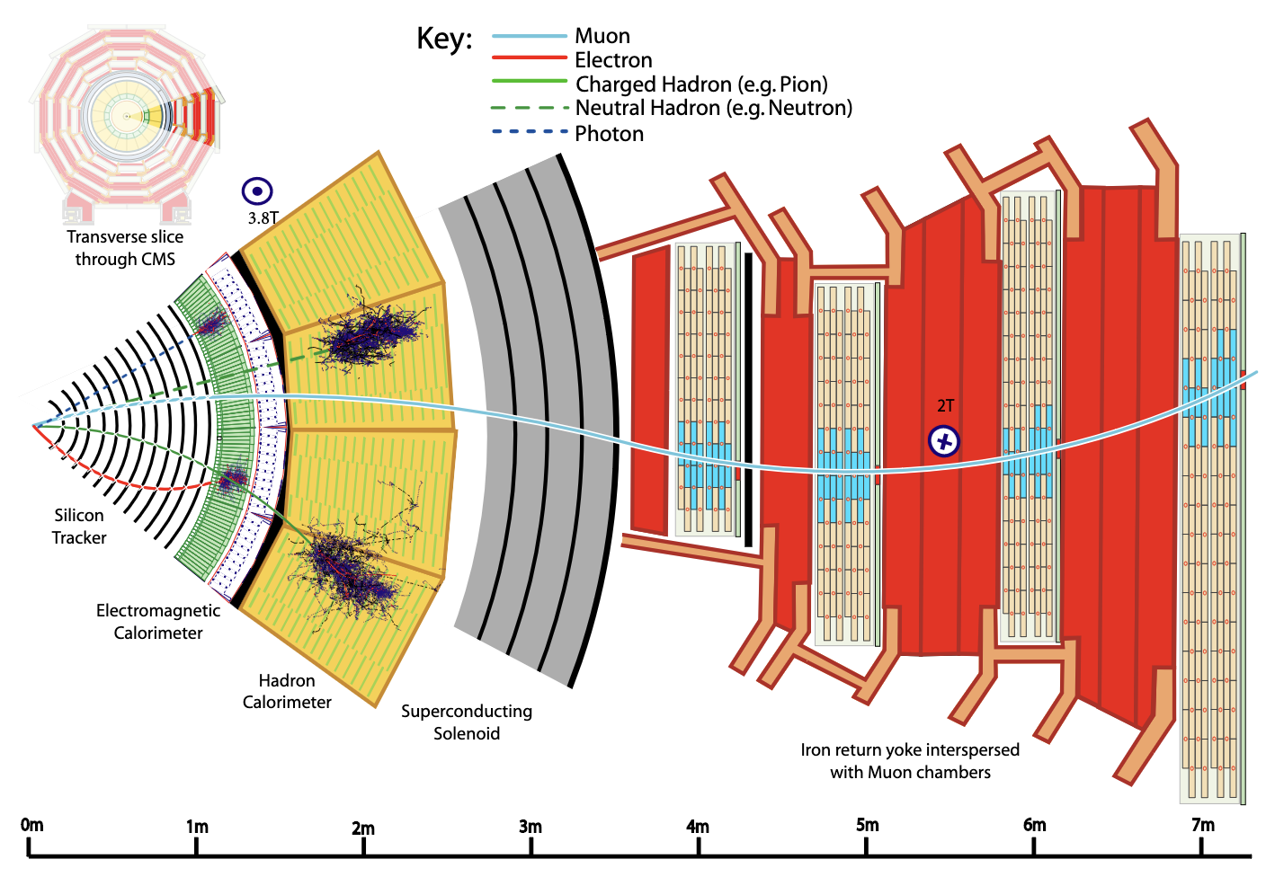
Compact Muon Solenoid (CMS)
Silicon tracker
Solid-state pixel and strip detectors
Detects charged particle tracks
Electromagnetic calorimeter (ECAL)
Homogenous detector
Consists of 75,000 PbWO₄ crystals
Detects electromagnetically interacting particle showers
Hadronic calorimeter (HCAL)
Sampling calorimeter
Layers of plastic scintillator and brass absorbers
Detects neutral and charged hadrons
Solenoid Magnet
Bends charged particles to measure momentum and sign of charge
Muon chambers
Detects muons

Slide 8
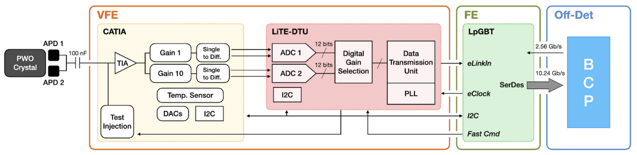
Technical Contributions (Part 1)
Working on Phase II upgrade for ECAL Barrel
The Phase II upgrade will entail a refurbishment of readout electronics of the ECAL Barrel to accommodate higher luminosity, higher L1 trigger rate, and latency requirement of the HL-LHC.
Reduced crystal operating temperature 18°C ➞ 9°C.
L1 trigger: 5x5 crystal granularity ➞ single crystal granularity
x3
BCP
FE
I’ve been working on running systems tests for new suite of on/off-detector readout hardware.
Developing high-level software for executing commands on hardware
Involved in 2023 test beam and analysis
VFE
Trigger tower
Passive Motherboard
APD
FPGA & ELM
Notes:
Rate = speed due to collision rate increase with HL – Latency = delay of electronics (for triggers + DAQ). Larger latency required due to increased processing. Requires more memory (RAM).
Reduced crystal operating temperature 18C -> 9C keeps radiation induced noise in avalanche photodiodies (APDs) below 250 MeV. (The aging of the crystals, which causes a loss of their transparency as well as increased leakage currents in the APDs, will be mitigated by lowering the operating temperature from 18 °C to 9 °C )
The front-end and the back-end electronics will be replaced during Long Shutdown 3 (2023-2027) to cope with the 7.5 fold increase in Level 1 (L1) trigger and readout rate and to achieve a timing resolution of 30 ps for photons and electrons with E ≥ 50 GeV. An on-detector data compression scheme in combination with high bandwidth optical connections allows single crystal information to be sent from the on-detector electronics to the off-detector processor boards at the LHC collision rate of 40 MHz.
All crystals used to trigger because we have high speed optics (cables) and can process data faster (FPGA).
The 30 ps time resolution can be used to determine the vertex position with 1 cm precision and is achieved with a shorter pulse shape and a four times higher sampling rate compared to the current ECAL.
MY WORK:
Verify firmware mapping of registers on BCP
Each ECAL corresponds to a readout channel. Wrote tests to verify long-term channel stability (errors, alignment of messages/words)
Develop high-level software for writing/reading BCP registers and executing commands on hardware (configure, align BCP, optimize pedestal ADCs from APD voltage)
Originally run on lpGBT (on FE) vs now running on ELM (on BCP) for increased speed
Updated high-level software to accommodate firmware change allowing for multiple trigger towers per BCP
Write tests to check patch panel configuration
Updated high-level software to accommodate firmware change allowing for multiple trigger towers per BCP
Originally run on lpGBT (on FE) vs now running on ELM (on BCP) for increased speed
Convert test software procedures for test beams
Passive motherboard is from current ECAL hardware
(configure, align words, optimize pedestal ADCs from APD voltage)
Took test beam shifts, preparation of high-level software for real-world environment rather for tests. My part in the analysis involves generating templates of signal shape from physics events.

Slide 9
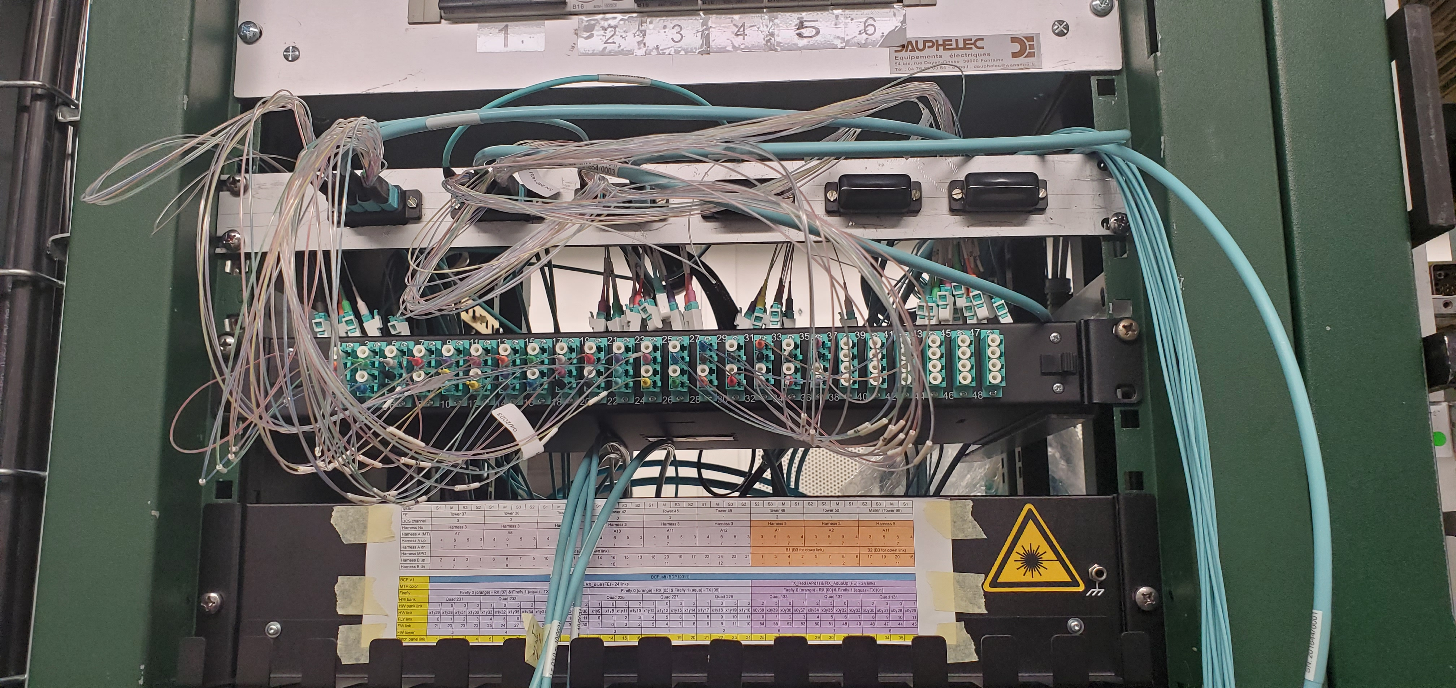
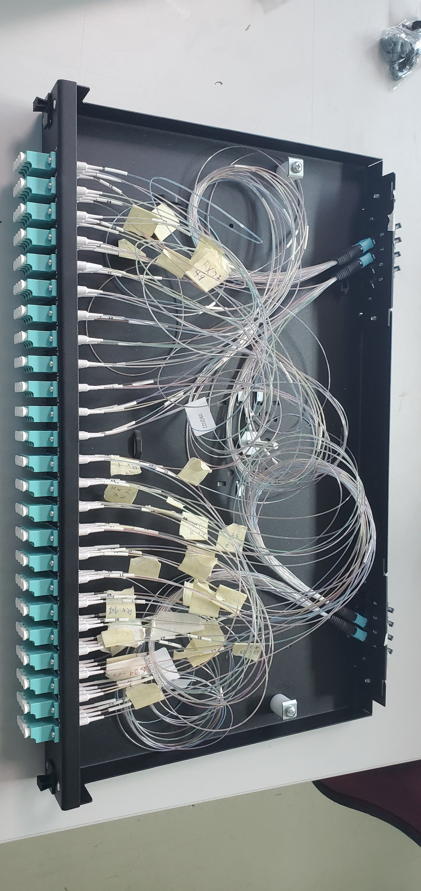
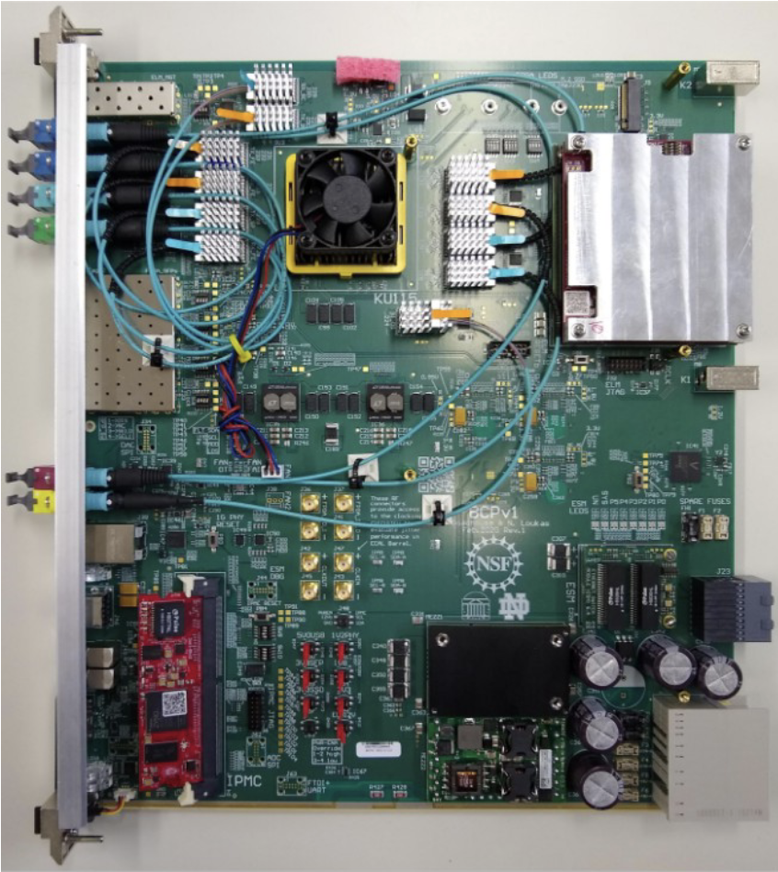
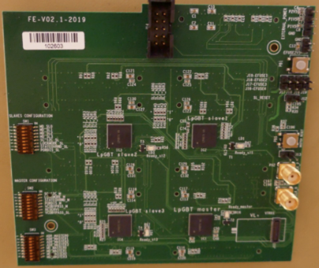
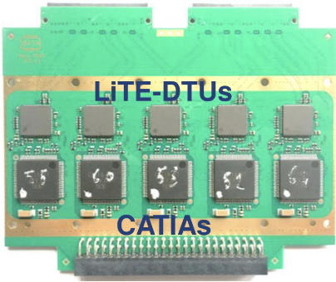
Below: Additional patch panel configuration for a second BCP before July 2023 test beam.
lpGBTs
Set up patch panels for additional hardware
Write tests to check patch panel configuration
Prepare hardware for test beams
FPGA
ELM
Notes:
FPGA = fully programable gate array
ELM = Embedded Linux Mzzanine
4 lpGBTs: 1 master to talk to BCP, 3 slaves. Receive clock and control signals from BCP and send signals from VFEs to off-detector BCP.
”additional hardware” = extra BCP in 892
Prepare hardware for test beams = take apart test stand in 892 and put it back together in H4

Slide 10
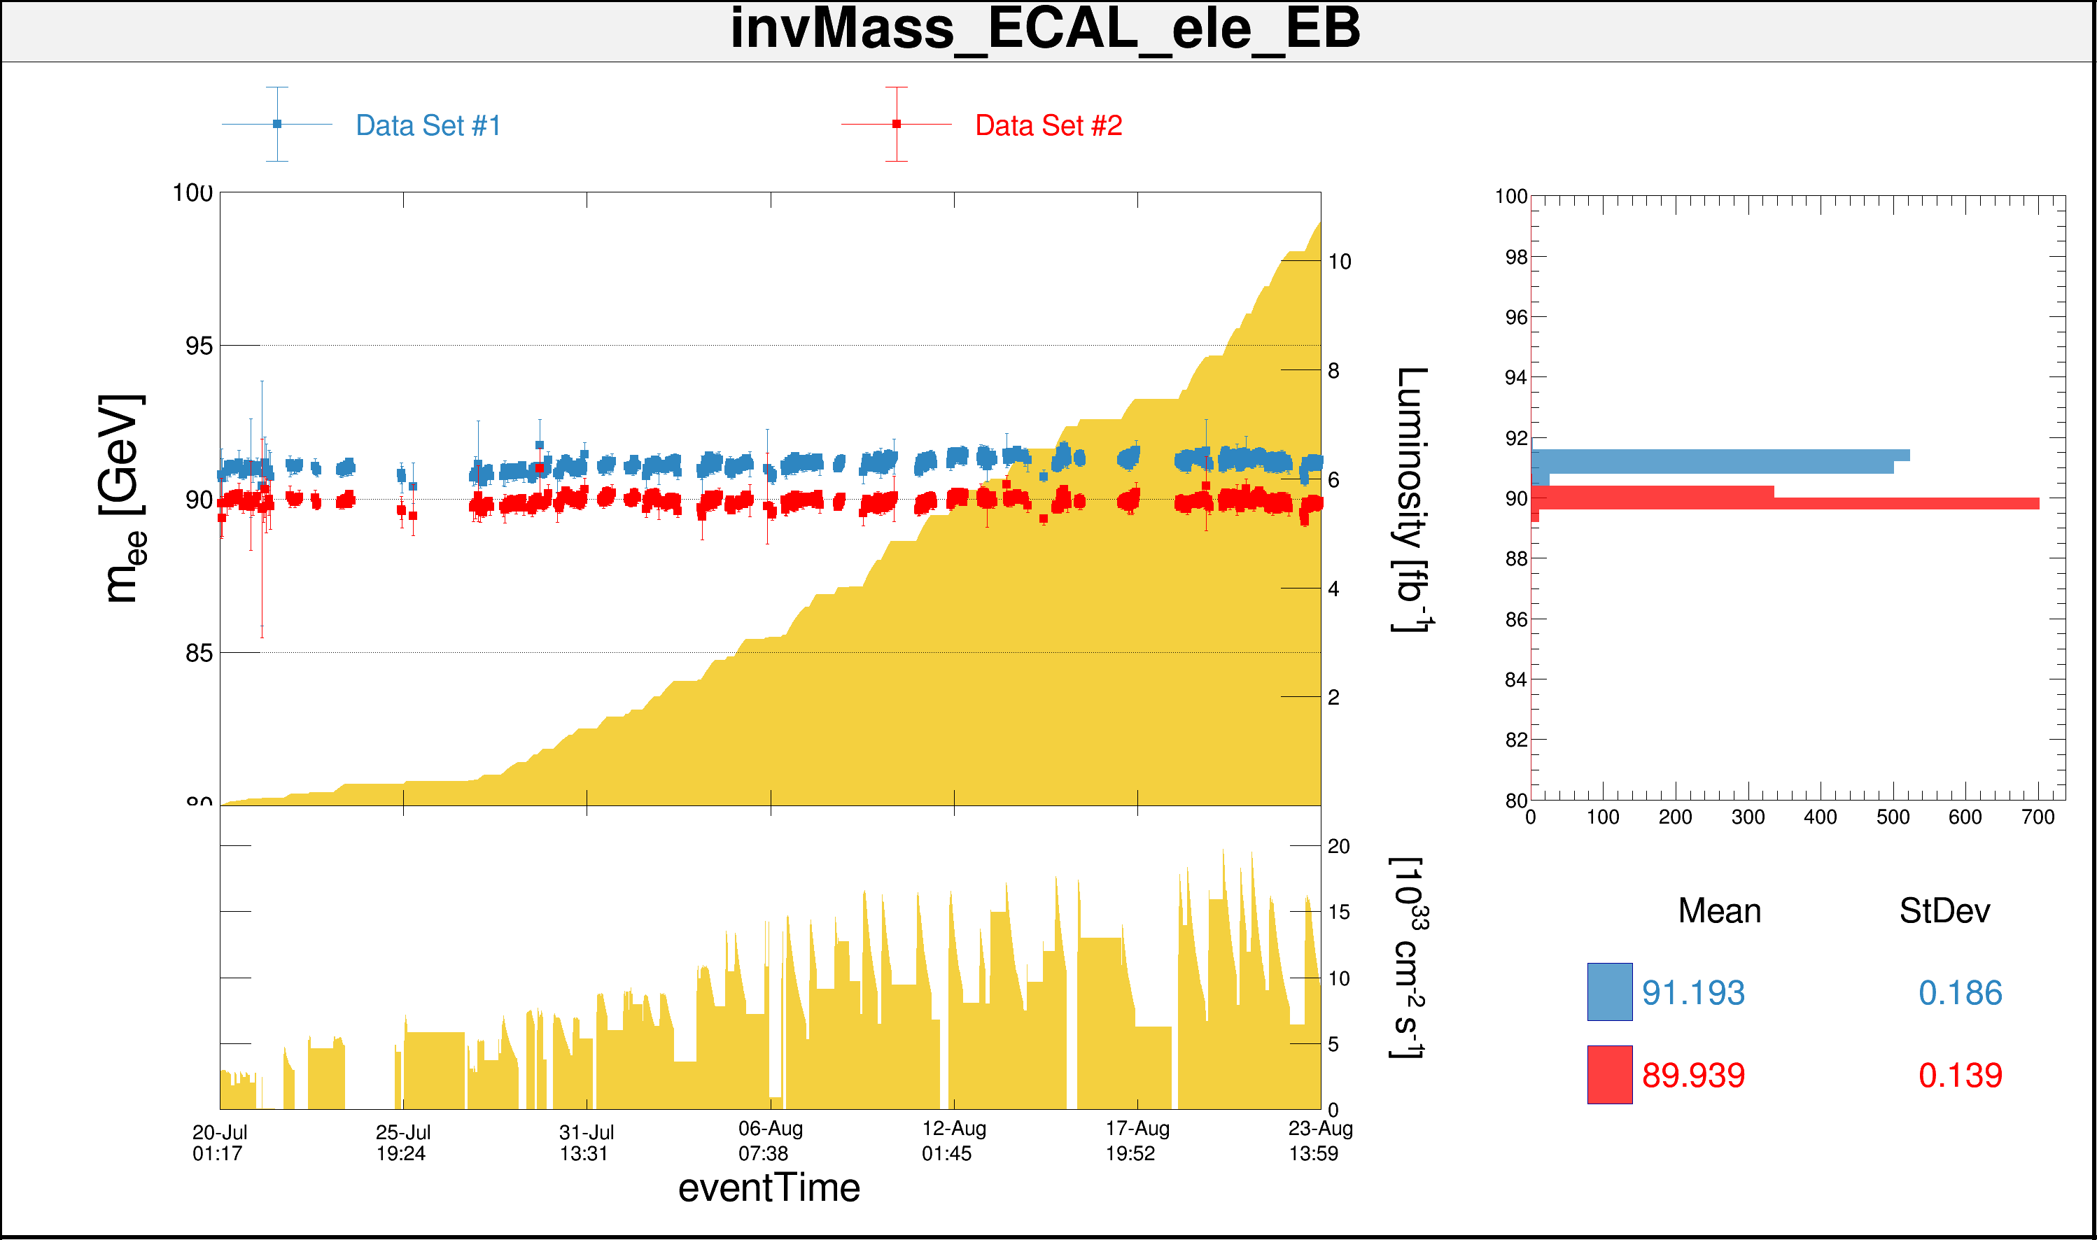
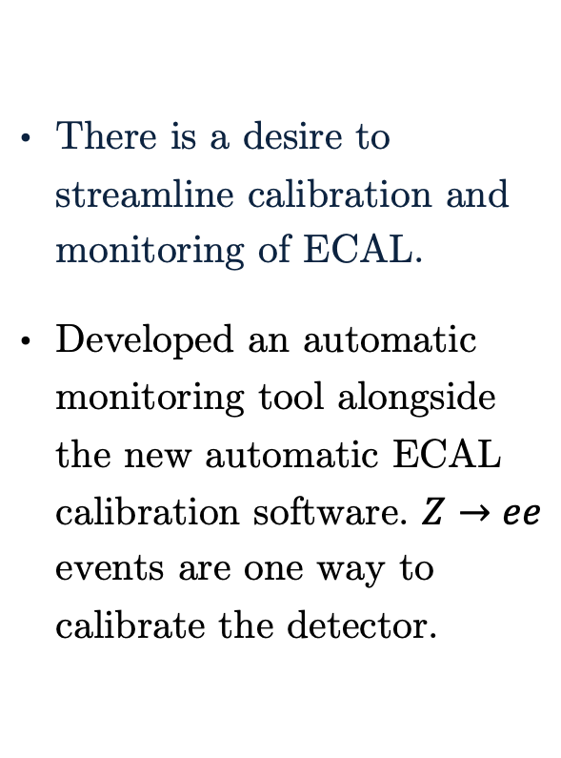
Technical Contributions (Part 2)
There is a desire to streamline calibration and monitoring of ECAL.
Developed an automatic monitoring tool alongside the new automatic ECAL calibration software. $Z→ee$ events are one way to calibrate the detector.
Notes:
Absolute calibration from Zee events. More calibration is done, but this is one part of it.
Monitoring tool implemented alongside the automatic calibration workflow. Shows pre-calibrated and post-calibrated Z->ee mass.Z mass = 91 GeV → BLUE is calibrated

Slide 11
The Standard Model and Beyond
LHC, CMS, Technical Contributions
Introduction to Analysis
Sample Generation
Event Selection
Signal Modelling
Advancements on Previous Studies
Summary
Notes:
Introduction – what am I doing? Basic why is it interesting?
The Standard Model and Beyond – theory stuff
LHC and CMS – also mention service work here briefly
Sample Generation – signal MC and event mixing part
Event Selection – cuts, BDT, categorization
Signal Modelling – signal modelling + note on background fits
Advancements on Previous Studies – exactly what it sounds like
Summary – put everything together for questions
REMEMBER TO INCLUDE PLOTS!!!!!!!

Slide 12
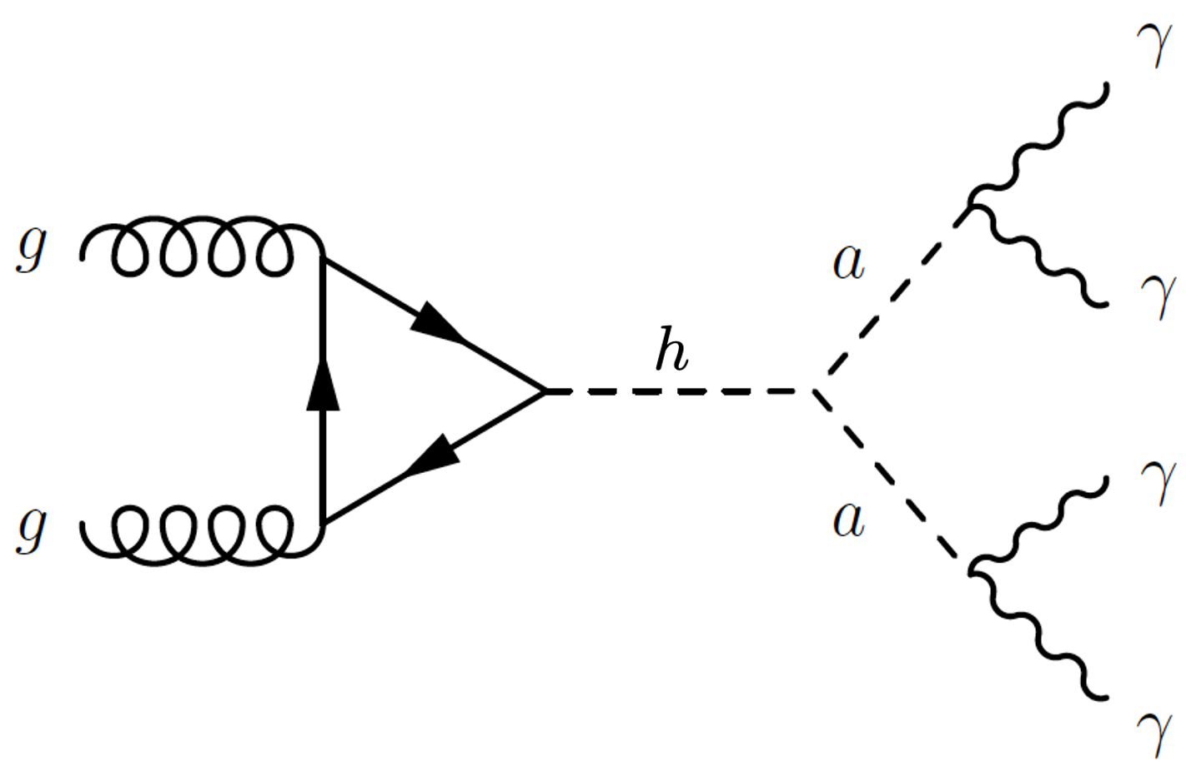
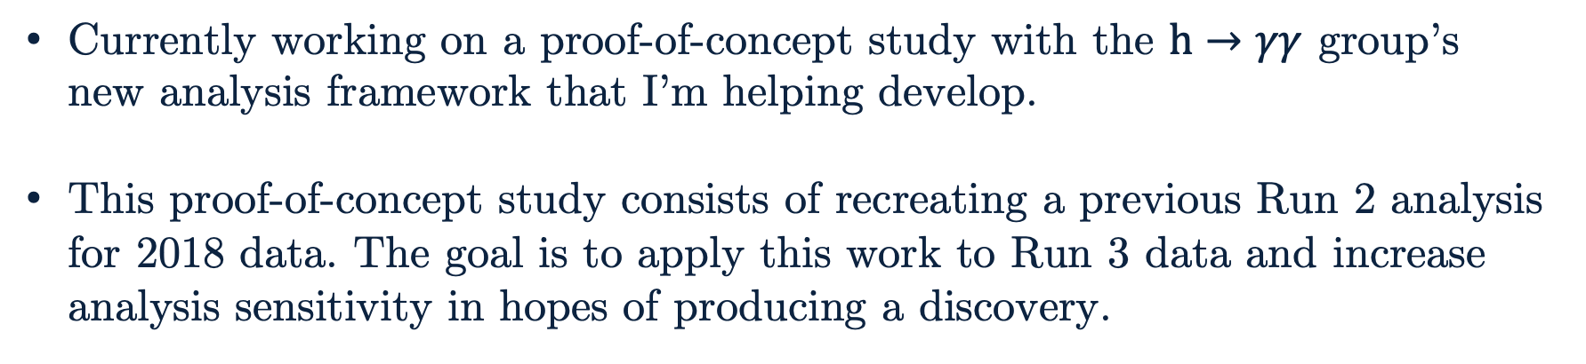
Introduction to Analysis
(Fully resolved)
Clean final state with low SM background
Model agnostic search allows for greater impact of any limits or discovery
Improved sensitivity could allow for a discovery
Currently working on a proof-of-concept study with the $h→γγ$ group’s new analysis framework that I’m helping develop.
This proof-of-concept study consists of recreating a previous Run 2 analysis for 2018 data. The goal is to apply this work to Run 3 data and increase analysis sensitivity in hopes of producing a discovery.
Notes:
In comparison to the boosted H to 4 photon analysis!!! Also, mention the Run 2 proof-of-concept study analyzing Run 2 with the hgg group’s new framework….

Slide 13
The Standard Model and Beyond
LHC, CMS, Technical Contributions
Introduction to Analysis
Sample Generation
Event Selection
Signal Modelling
Advancements on Previous Studies
Summary
Notes:
Introduction – what am I doing? Basic why is it interesting?
The Standard Model and Beyond – theory stuff
LHC and CMS – also mention service work here briefly
Sample Generation – signal MC and event mixing part
Event Selection – cuts, BDT, categorization
Signal Modelling – signal modelling + note on background fits
Advancements on Previous Studies – exactly what it sounds like
Summary – put everything together for questions
REMEMBER TO INCLUDE PLOTS!!!!!!!

Slide 14
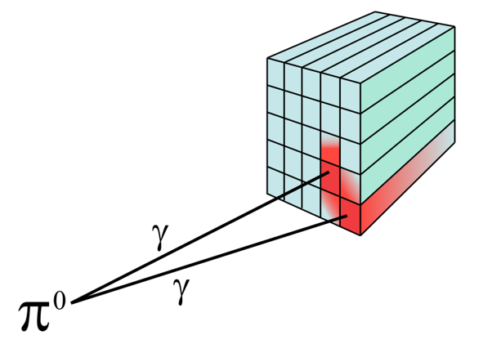
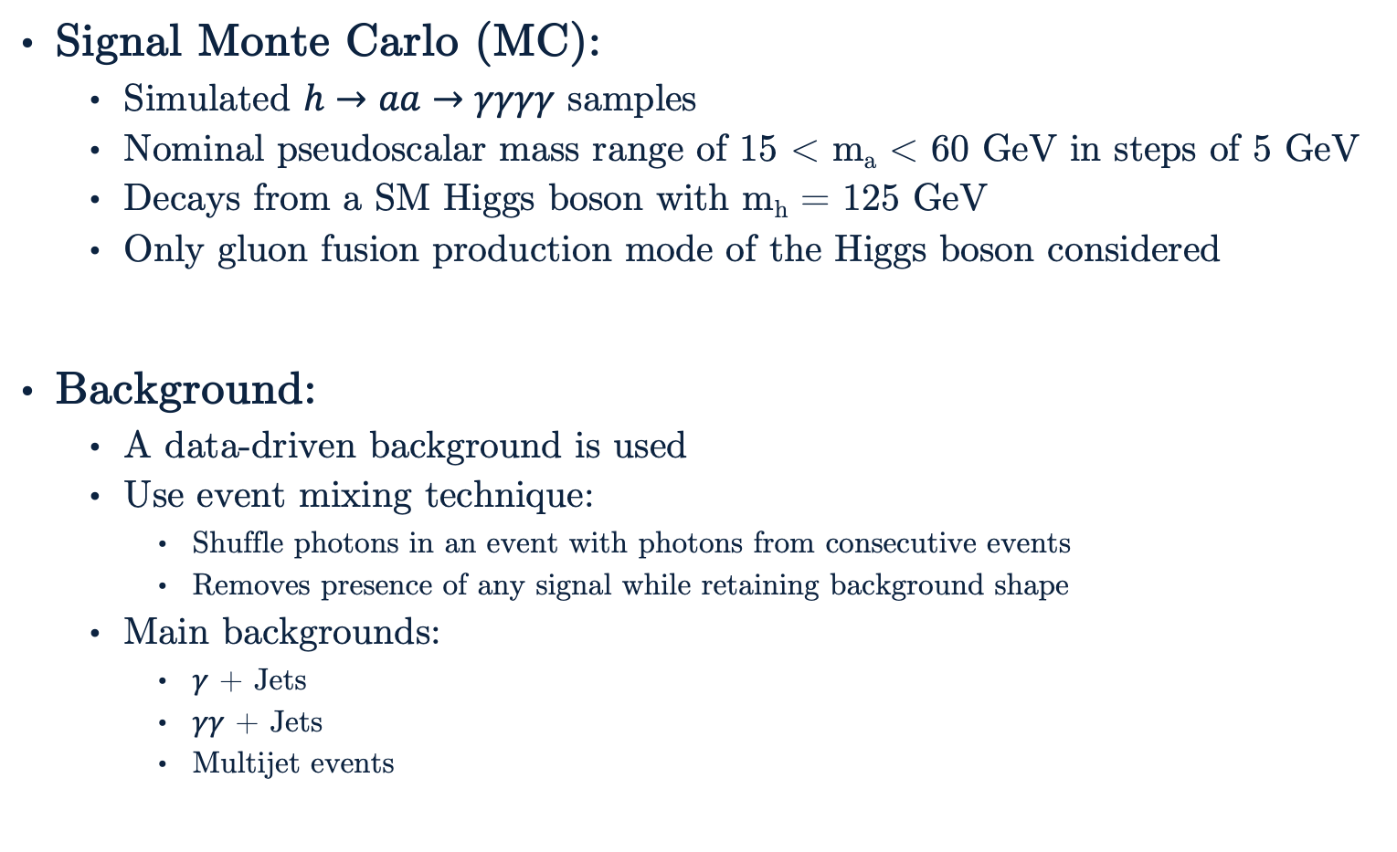
Sample Generation
Signal Monte Carlo (MC):
Simulated $h→aa→γγγγ$ samples
Nominal pseudoscalar mass range of 15 < m_{a} < 60 GeV in steps of 5 GeV
Decays from a SM Higgs boson with m_{h} = 125 GeV
Only gluon fusion production mode of the Higgs boson considered
Background:
A data-driven background is used
Use event mixing technique:
Shuffle photons in an event with photons from consecutive events
Removes presence of any signal while retaining background shape
Main backgrounds:
$γ$ + Jets
$γγ$ + Jets
Multijet events
Tracker
ECAL
Notes:
Signals:
Pseudoscalar mass bounded low by photons being collimated (boosted photons search) and high by Higgs mass
Only use gluon fusion because it’s a clean production mode (compared to say VBF which would increase background)
Backgrounds:
Either photons from hard scatter (collision) or isolated photons reconstructed due to highly collimated decays fragmented from jets (fake photons) like merged neutral pions.
Fakes: neutral pion can be reconstructed as one photon. Other ways are for real photons (irreducible) from the PV combined along fake photons (e.g. neutral pions) from jets (reducible since a better detector could resolve it). Jets containing a large electromagnetic fraction can be mistaken for photons.
$γ$ + jets:
Direct photon (mostly quark-gluon Compton scattering, qg → qγ, or quark-antiquark annihilation, q ¯q → γg), originated during the hard process
Fragmentation photon, produced in the fragmentation of a quark with high pT. Fragmentation is when partons evolve into a collection of hadrons.
$γγ$ + jets:
Comes from gg-> $γγ$g + X at leading order.
Can’t have QCD vertex to 3$γ$ since it violates charge conservation.
Multijet events:
4 jets that are fake photons (with high electromagnetic content so they shower in ECAL)

Slide 15
The Standard Model and Beyond
LHC, CMS, Technical Contributions
Introduction to Analysis
Sample Generation
Event Selection
Signal Modelling
Advancements on Previous Studies
Summary
Notes:
Introduction – what am I doing? Basic why is it interesting?
The Standard Model and Beyond – theory stuff
LHC and CMS – also mention service work here briefly
Sample Generation – signal MC and event mixing part
Event Selection – cuts, BDT, categorization
Signal Modelling – signal modelling + note on background fits
Advancements on Previous Studies – exactly what it sounds like
Summary – put everything together for questions
REMEMBER TO INCLUDE PLOTS!!!!!!!

Slide 16
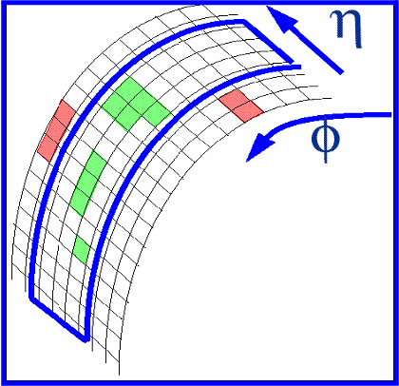
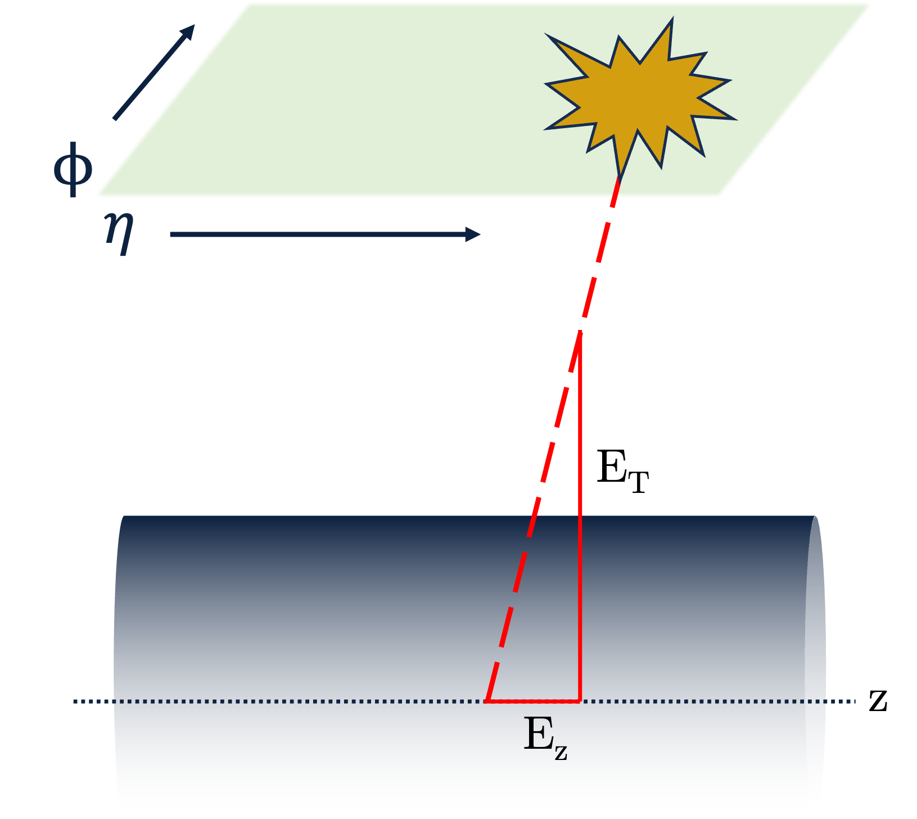
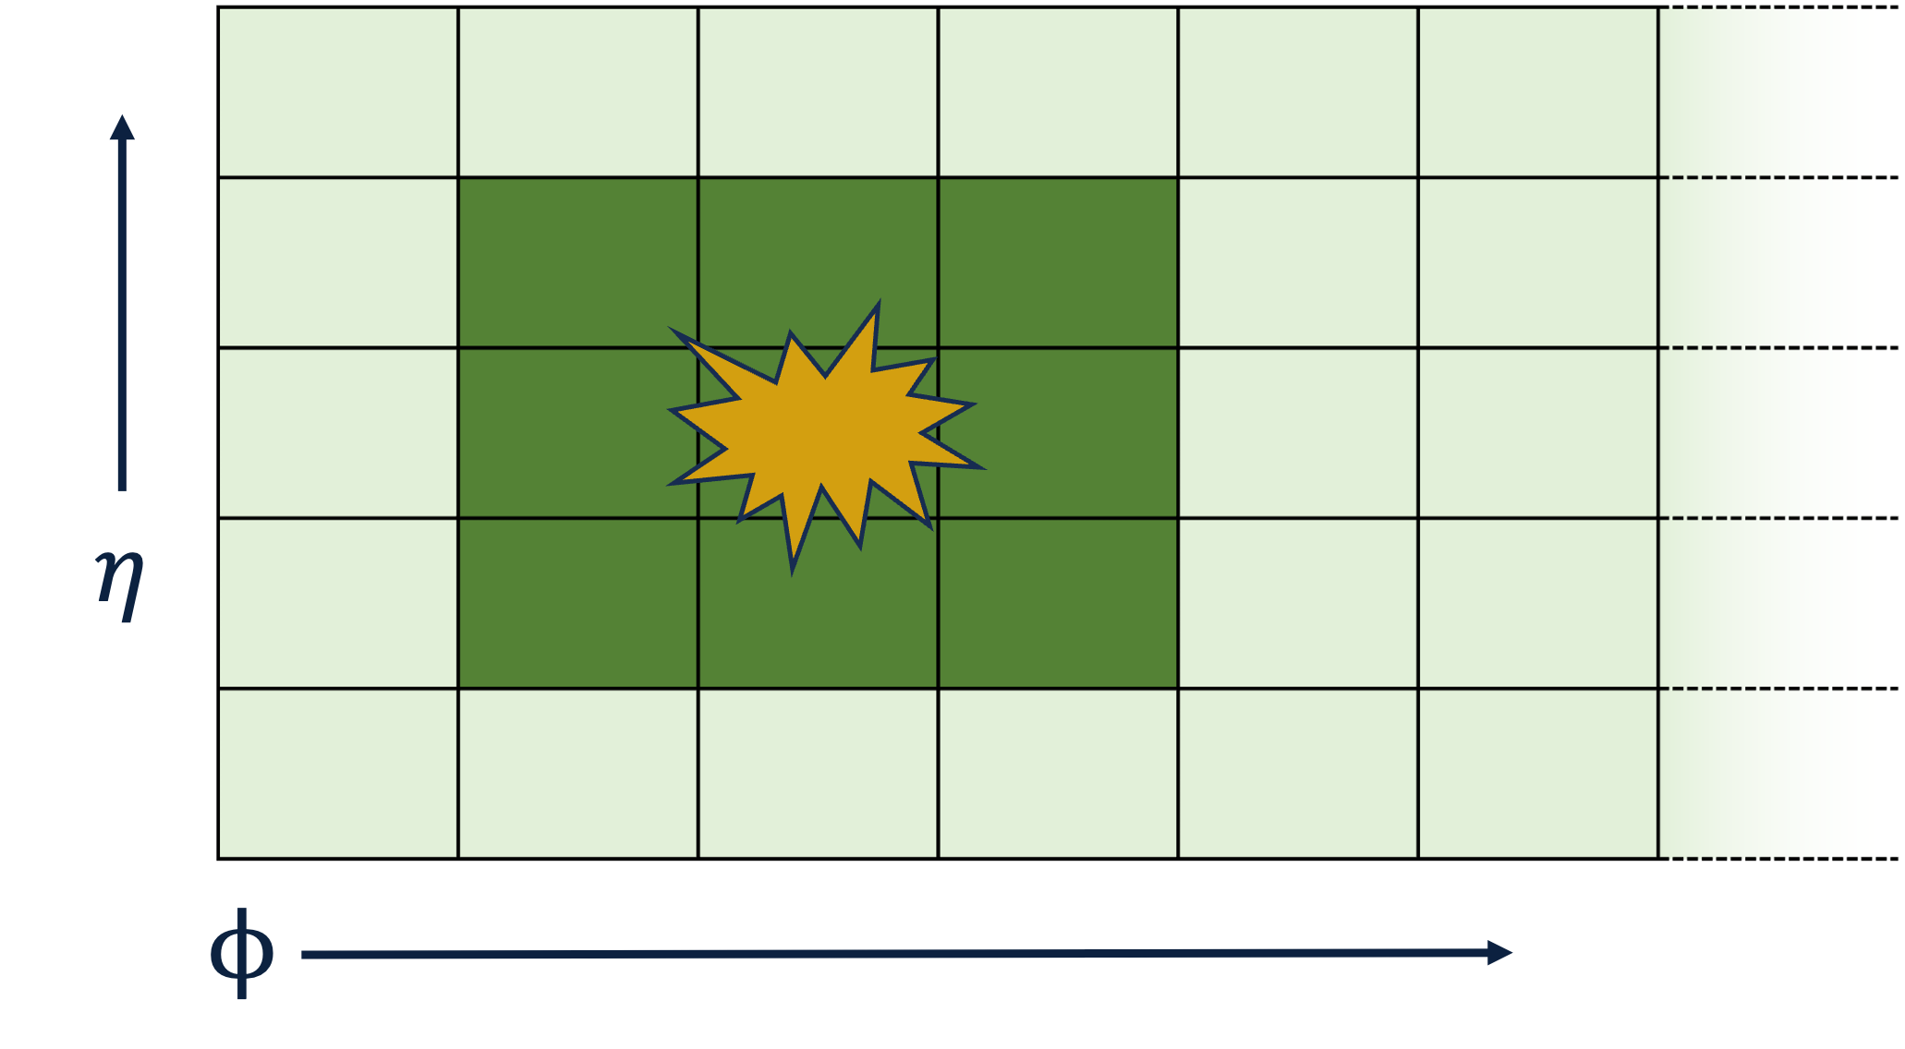
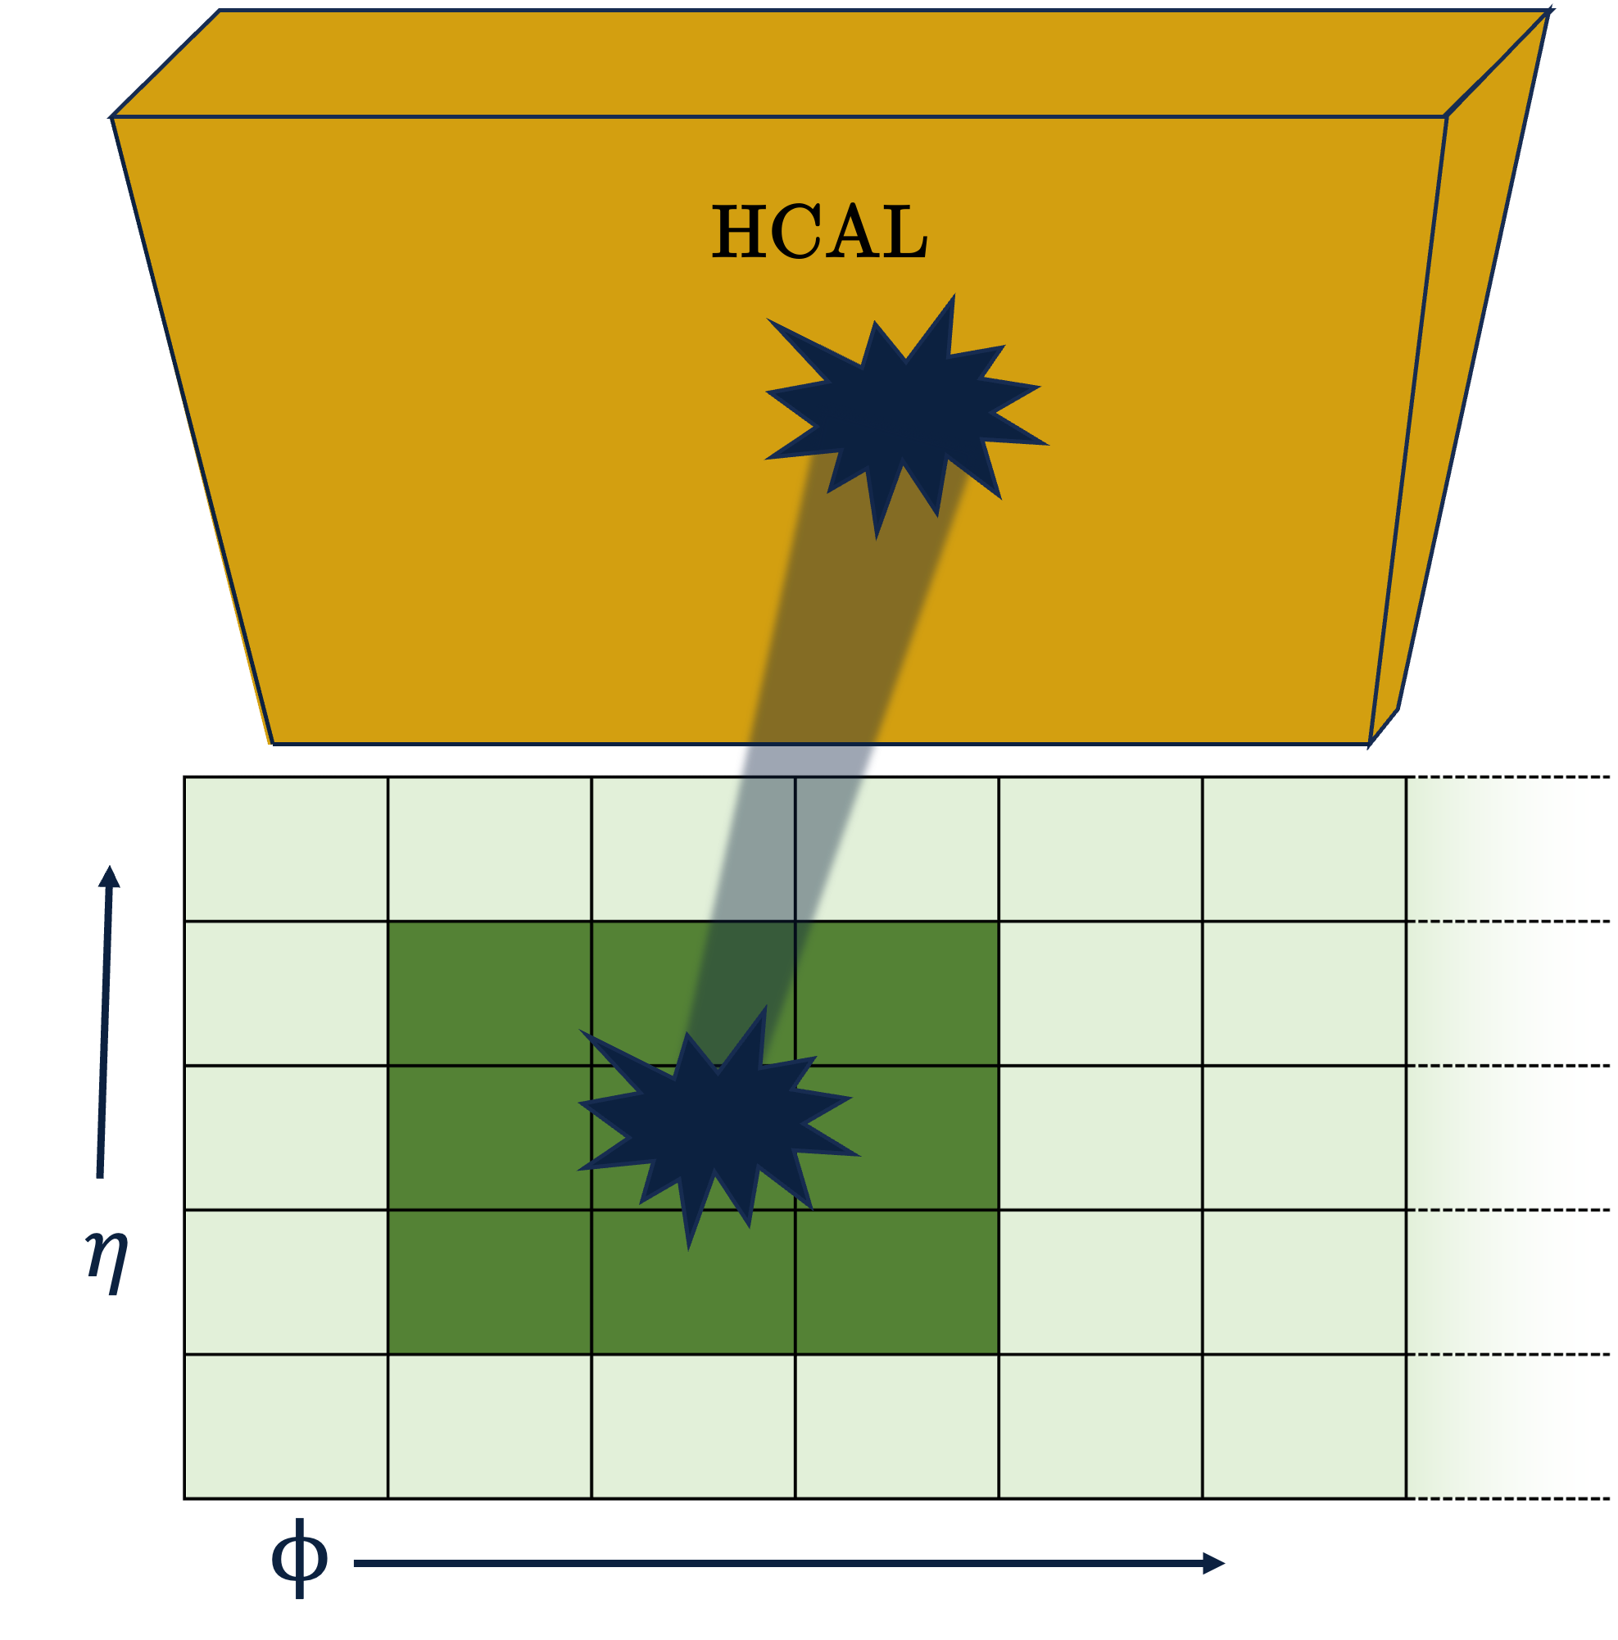
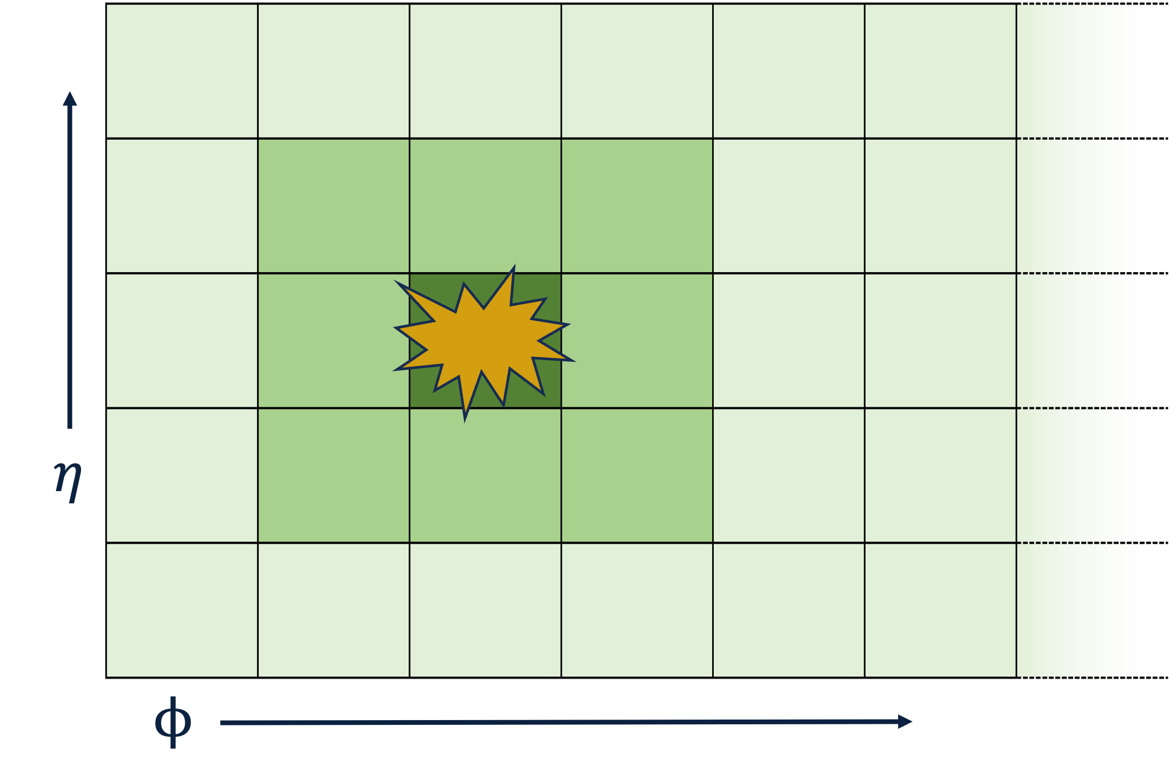
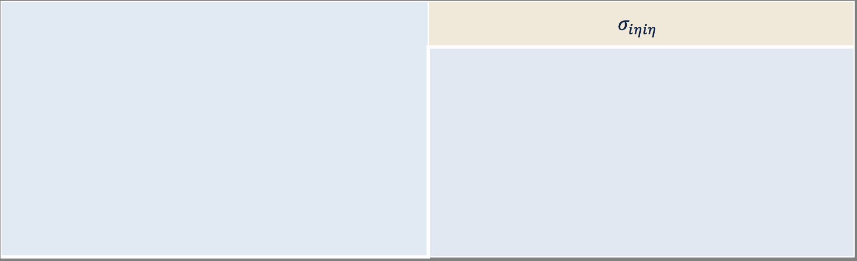
Choosing Candidate Photons
Energy deposition and shape of photon candidates:
E_{T}
 | R₉
Supercluster
H/E
 | $$σ_{iηiη}$$
Notes:
Important to know that the photon shower shape is that of a photon rather than a hadron and with enough resolution (ET).
Supercluster is a region in (eta,phi) space that contains multiple clusters (multiple hits?) in a narrow eta window and an extended phi window. Extended range in phi is needed due to bending of the particle’s path due to the magnetic field.
Energy deposits in several ECAL channels are clustered under the assumption that each local maximum above a certain energy threshold (1 GeV) corresponds to a single particle incident on the detector. An ECAL energy deposit may be shared between overlapping clusters, and a Gaussian shower profile is used to determine the fraction of the energy deposit to be assigned to each of the clusters. Because electrons and photons have a significant probability of showering when traversing the CMS tracker, by the time the particle reaches the ECAL, the original object may consist of several electrons and/or photons produced from bremsstrahlung and/or pair production. The multiple ECAL clusters need to be combined into a single SC that captures the energy of the original electron/photon.
ET: Transverse energy of a photon candidate measured in ECAL. ET = pT when massless
R9: Ratio of energy deposited in ECAL inside 3x3 crystals centered on the most energetic crystal in the supercluster and the supercluster energy. This variable makes a good separation between unconverted photons (energy not spread in tracker) and converted photons (energy spread by B-field before reaching ECAL) and is used to make this separation in the photon object.
H/E: Ratio of energy deposited in nearest HCAL tower and energy deposited in its supercluster.
Sigma_ieie: Energy weighted standard deviation of a single crystal’s $η$ within 5x5 crystals centered at the crystal with maximum energy. Jets have much larger spread in multiple crystals than photons.

Slide 17
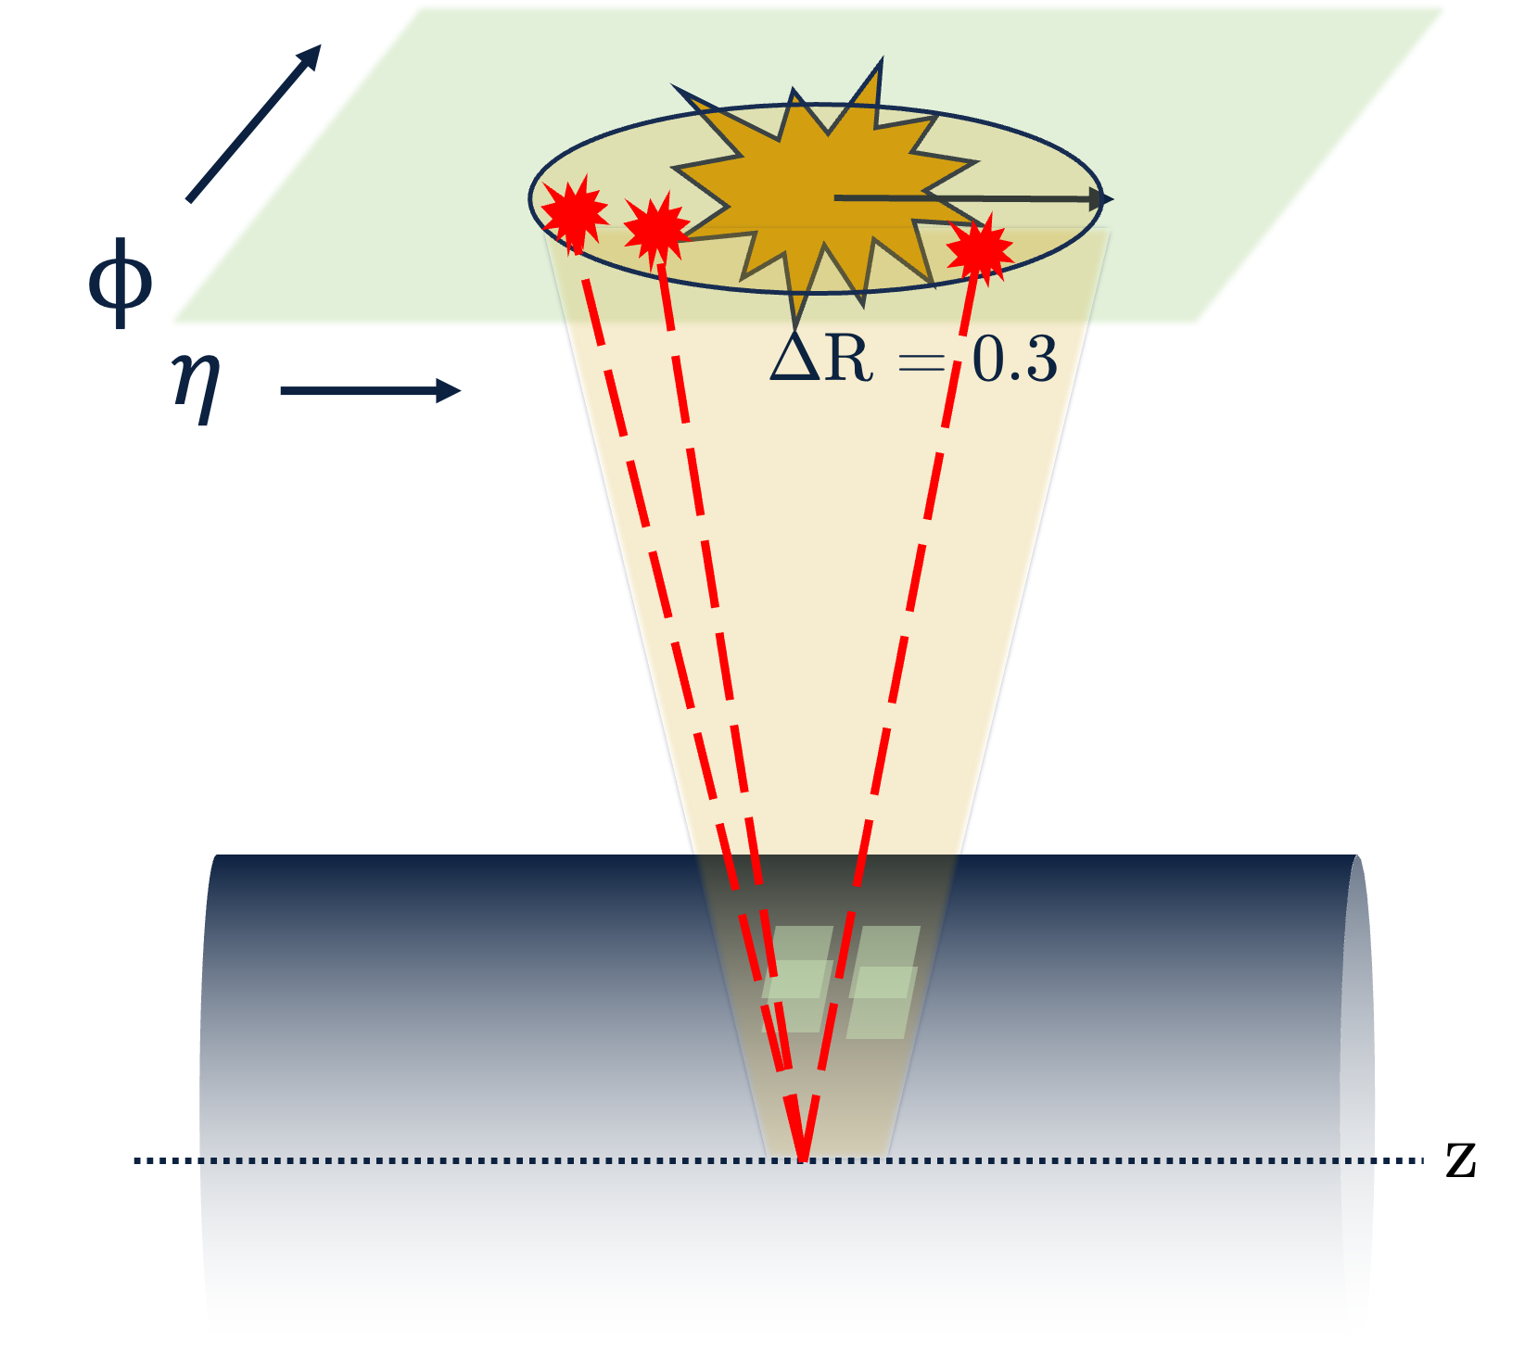
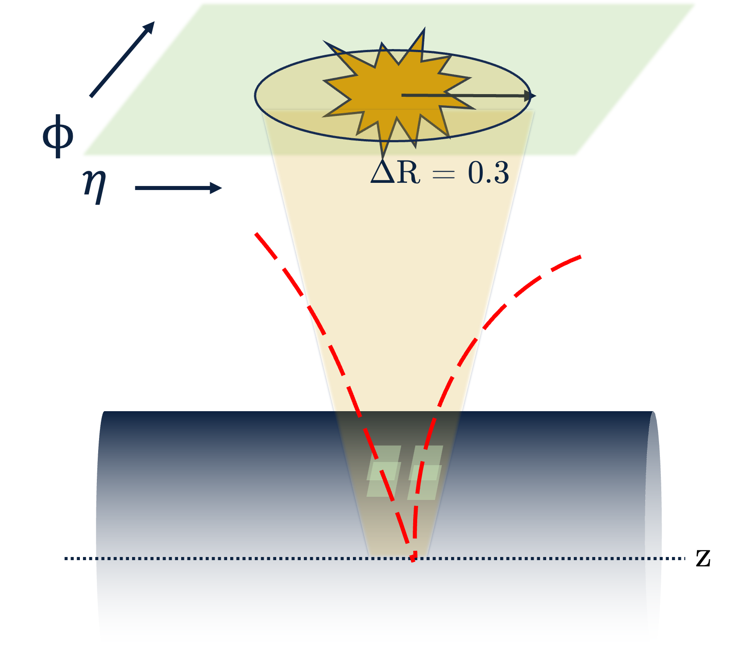
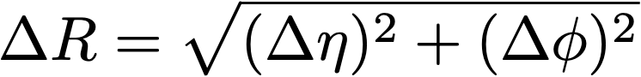

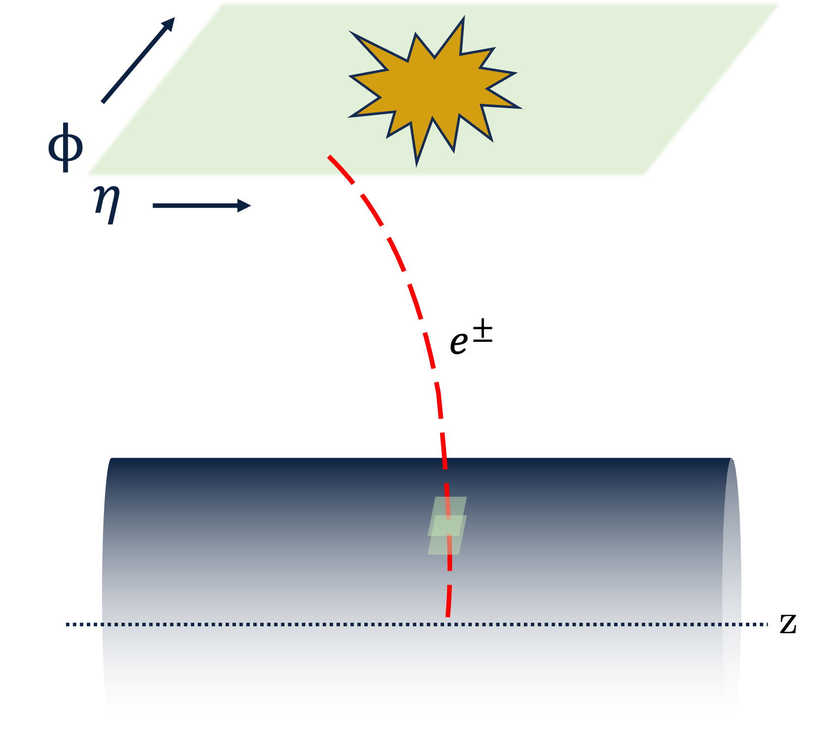
Choosing Candidate Photons
Isolation of photon candidates:
Photon Isolation
Tracker Isolation
Charged Hadron Isolation
Not restricted to a ΔR cone.
Electron
Veto
Notes:
Important to make sure photon candidates are isolated. It’s a good way to discriminate against fake photons from jet deacys.
Pho iso: Sum of E_{T} of all photon candidates within a cone of radius ΔR = 0.3 excluding candidate photon.
Tracker iso: Sum of track p_{T} within a cone of ΔR = 0.3.
Charged had iso: Sum of p_{T} of all charged hadron candidates within a cone of radius ΔR = 0.3.
E-veto: Checks that no electron candidate track matches photon candidate supercluster.

Slide 18
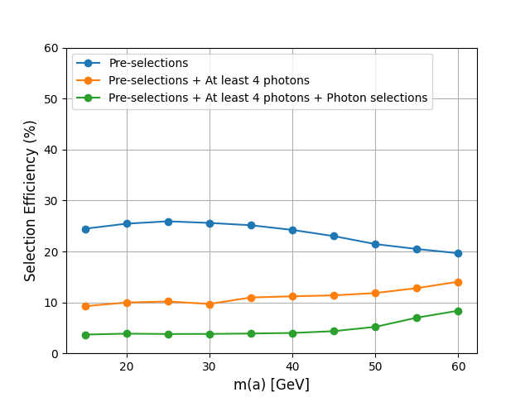
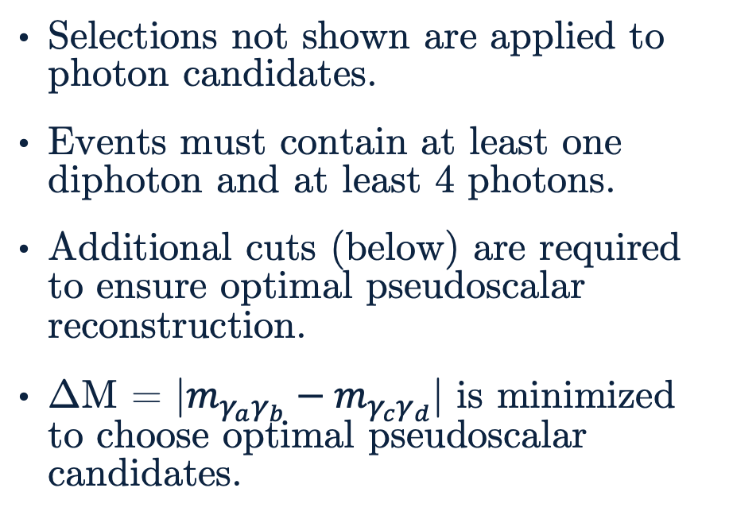
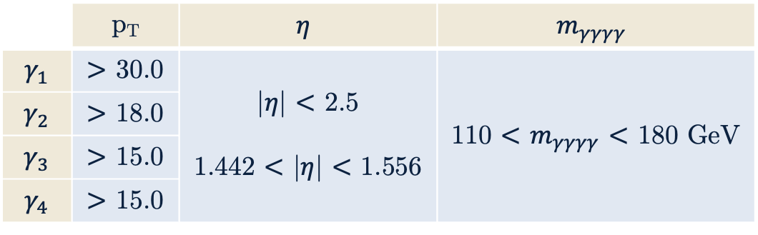
Selections
Selections not shown are applied to photon candidates.
Events must contain at least one diphoton and at least 4 photons.
Additional cuts (below) are required to ensure optimal pseudoscalar reconstruction.
ΔM = |$m_{γ_{a}γ_{b}}−m_{γ_{c}γ_{d}}$| is minimized to choose optimal pseudoscalar candidates.
 | p_{T} | $$η$$ | $$m_{γγγγ}$$
$$γ_{1}$$ | $>$ 30.0 | |$η$| $<$ 2.5 1.442 $<$ |$η$| $<$ 1.556 | 110 $<$ $m_{γγγγ}$ $<$ 180 GeV
$$γ_{2}$$ | $>$ 18.0
$$γ_{3}$$ | $>$ 15.0
$$γ_{4}$$ | $>$ 15.0
Above: Efficiencies of selections at various stages of selections for all nominal pseudoscalar mass points.
Left: Additional selections applied to photons passing pre-selections.
Notes:
Since selections are optimized for low mass diphoton search, the requirement of at least one diphoton ensure that photons are sufficiently. DO NOT MENTION BAD EFFICIENCY PROBLEMS!

Slide 19
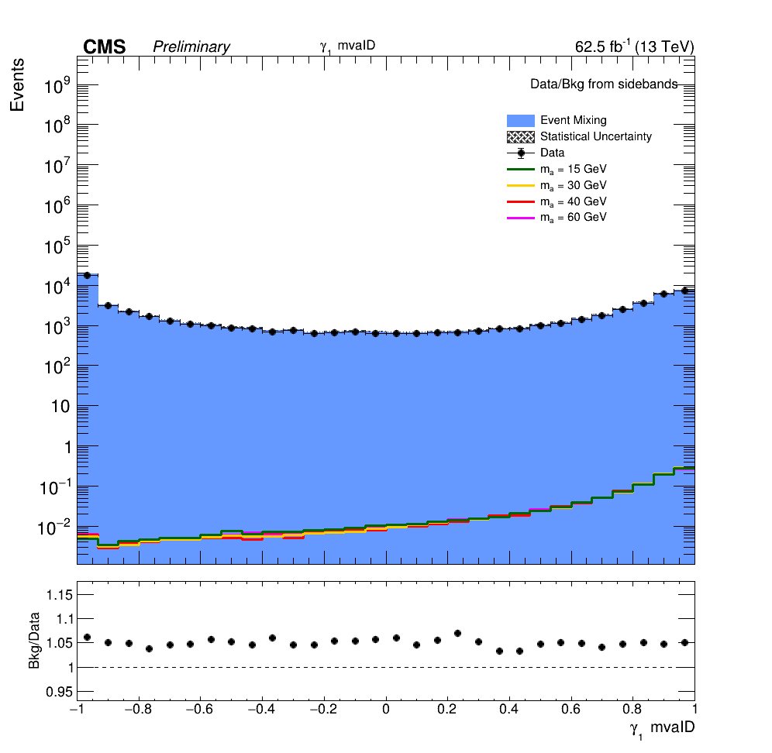
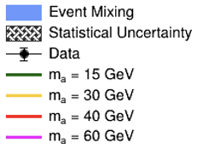
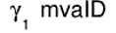
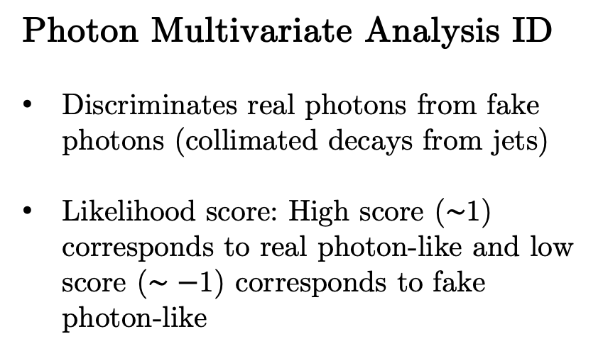
Results of Selections
Photon Multivariate Analysis ID
Discriminates real photons from fake photons (collimated decays from jets)
Likelihood score: High score ($∼$1) corresponds to real photon-like and low score ($∼−$1) corresponds to fake photon-like

Slide 20
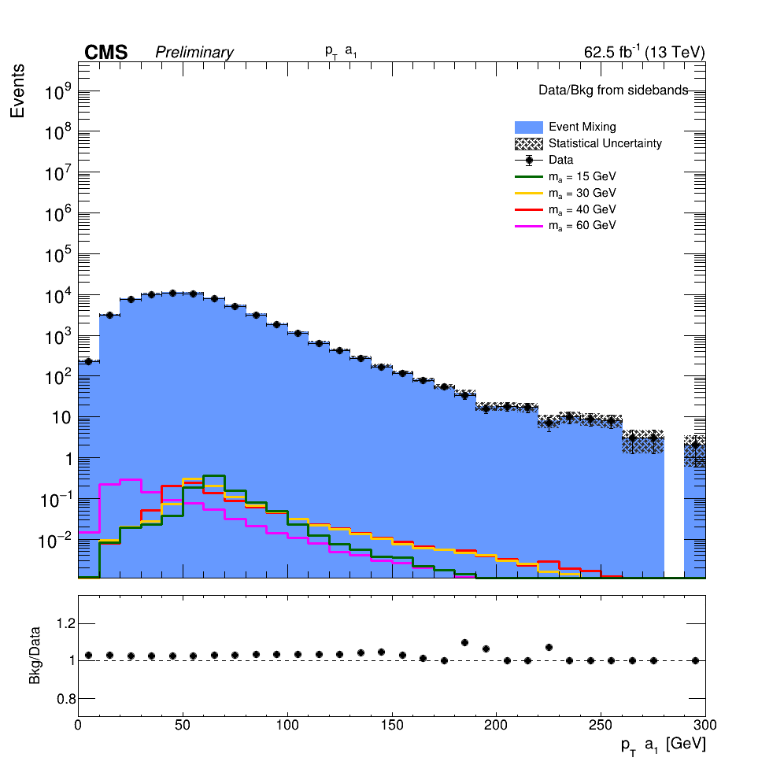
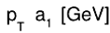
Results of Selections
Looking at pseudoscalar kinematics:
p_{T} peak moves left with increasing mass
ΔR peaks move right with increasing mass means less boosting as pseudoscalar mass increases

Slide 21
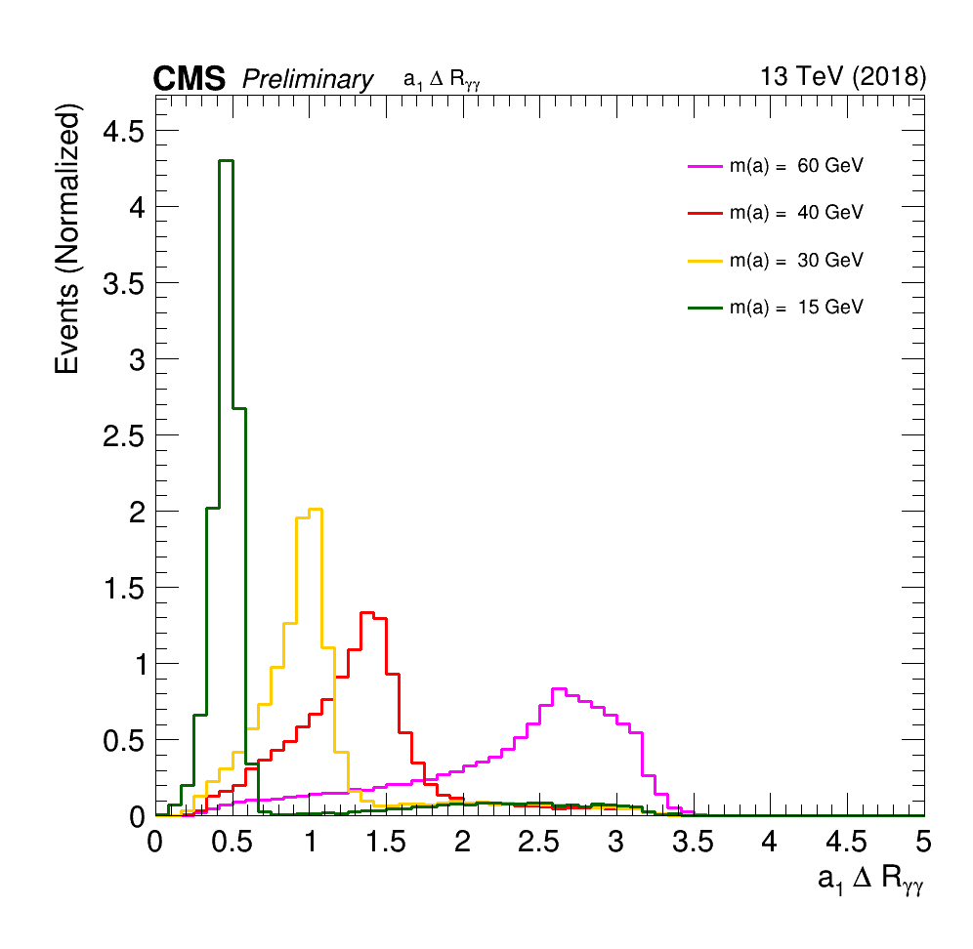
Results of Selections
Looking at pseudoscalar kinematics:
p_{T} peak moves left with increasing mass
ΔR peaks move right with increasing mass means less boosting as pseudoscalar mass increases

Slide 22
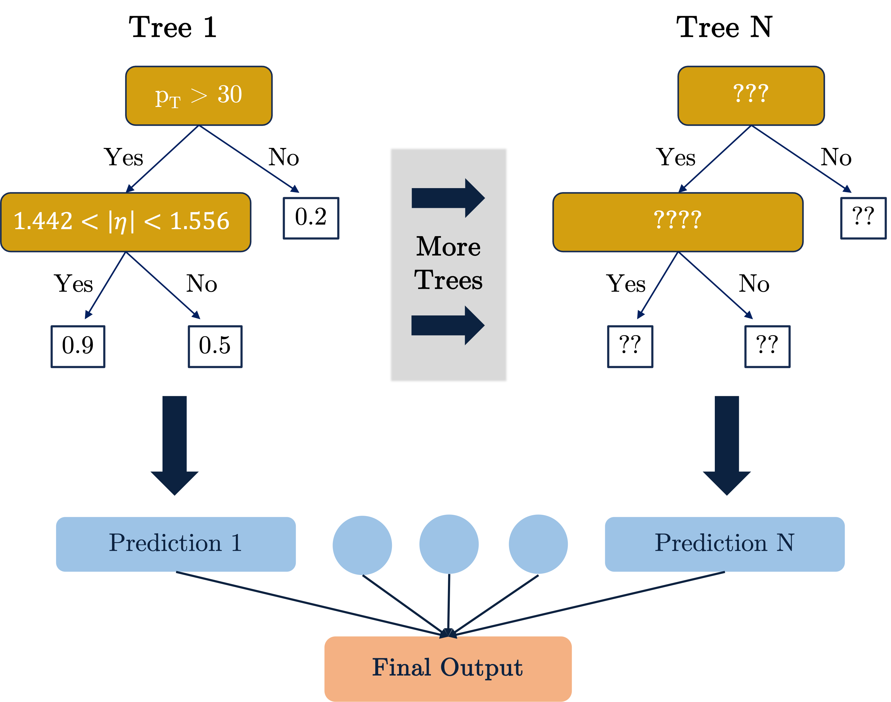
Event Selection BDT
What is a BDT?
Boosted Decision Tree
Combination of many weak learners (trees) into a strong classifier
Need a BDT to better distinguish signal-like events from background-like events
A BDT can significantly improve analysis sensitivity compared to a purely cut-based analysis.
Aim to assign high scores to events with four photons that fulfill the following criteria:
Signal-like kinematic characteristics
Good 4-photon mass resolution
High scores from the photon multivariate analysis in the “photon-like” region
Only one BDT model is required for the entire event selection.

Slide 23
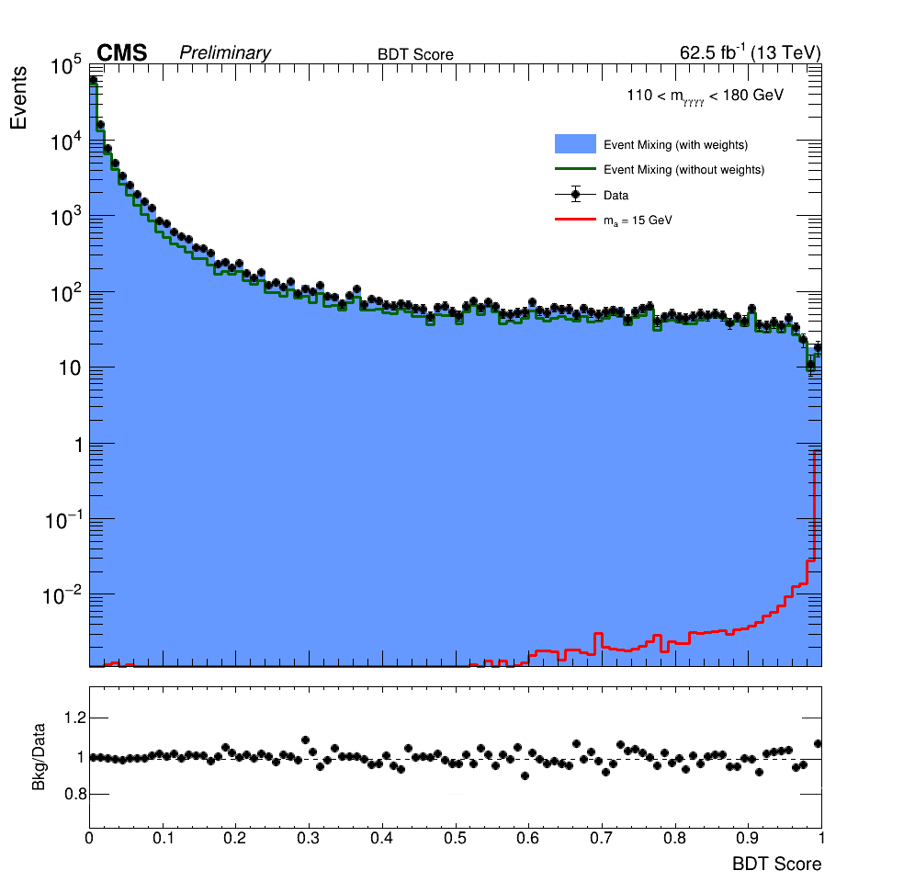
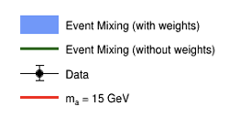
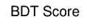
Applying the Event Selection BDT
The event selection BDT model is applied to all samples for each nominal mass point.
For each nominal mass point:
Signal MC, event mixed background, and data are all processed with the BDT, configured for the given mass point.
A prediction distribution of event selection BDT score is generated for signal MC, event mixed background, and data. Shown for m_{a} = 15 GeV.

Slide 24
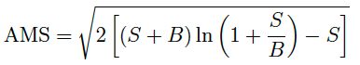
BDT Score Categorization
The goal of the event selection procedure is to maximize sensitivity of the analysis.
Categorization is performed on BDT score as a technique to improve event selections and thus analysis sensitivity.
Events are divided into categories to:
Achieve a higher signal to background ratio
Improve mass resolution
Category boundaries are determined by maximizing significance, where significance is defined as:
Notes:
Analysis sensitivity:
How to increase analysis sensitivity:
Statistics
Better estimation of background
Improved event selection procedure
Optimal events means events that have signal-like kinematic characteristics, good 4-photon mass resolution, and high scores from the photon multivariate analysis in the “photon-like” region. (From main BDT slide)
In order to increase the sensitivity of the analysis, the events are divided into categories, such that “high-performance” categories are characterized by a higher signal-to-background ratio and/or better mass resolution. The categorization is performed based on the output of the BDT event classifier.
Higher signal to background comes from the fact that we’re choosing BDT scores with optimal event characteristics such that with real data, more potential signal events would be retained.
Only one categoryis used and only the events within that category are kept.
This directly improves sensitivity!!! Your ability to extract a signal event is increased due to the optimal event characteristics of events within this category.

Slide 25
The Standard Model and Beyond
LHC, CMS, Technical Contributions
Introduction to Analysis
Sample Generation
Event Selection
Signal Modelling
Advancements on Previous Studies
Summary
Notes:
Introduction – what am I doing? Basic why is it interesting?
The Standard Model and Beyond – theory stuff
LHC and CMS – also mention service work here briefly
Sample Generation – signal MC and event mixing part
Event Selection – cuts, BDT, categorization
Signal Modelling – signal modelling + note on background fits
Advancements on Previous Studies – exactly what it sounds like
Summary – put everything together for questions
REMEMBER TO INCLUDE PLOTS!!!!!!!

Slide 26
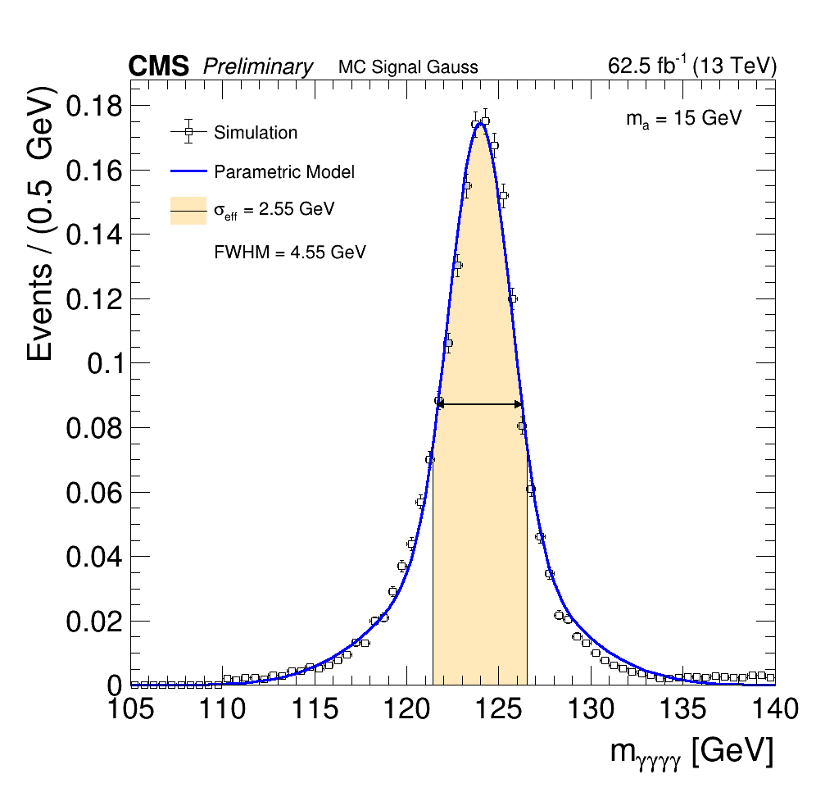
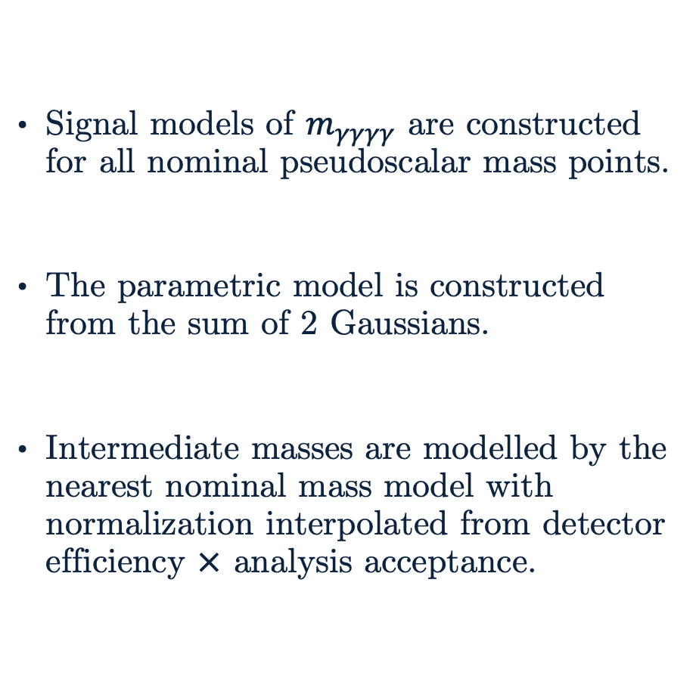
Signal Modelling
Signal models of $m_{γγγγ}$ are constructed for all nominal pseudoscalar mass points.
The parametric model is constructed from the sum of 2 Gaussians.
Intermediate masses are modelled by the nearest nominal mass model with normalization interpolated from detector efficiency $×$ analysis acceptance.
m_{a} = 15 GeV
Notes:
Note: Only testing events from the event selection BDT are used. Line 384 AN. Don’t need to mention it since it’s distracting.
Category boundary cuts have not been applied before generating signal models yet due to issues with that step, although normally these cuts would be applied.
$σ_{eff}$ refers to the region in which 68% of signal events are contained and FWHM to the Full Width Half Maximum of the parametric model.

Slide 27
The Standard Model and Beyond
LHC, CMS, Technical Contributions
Introduction to Analysis
Sample Generation
Event Selection
Signal Modelling
Advancements on Previous Studies
Summary
Notes:
Introduction – what am I doing? Basic why is it interesting?
The Standard Model and Beyond – theory stuff
LHC and CMS – also mention service work here briefly
Sample Generation – signal MC and event mixing part
Event Selection – cuts, BDT, categorization
Signal Modelling – signal modelling + note on background fits
Advancements on Previous Studies – exactly what it sounds like
Summary – put everything together for questions
REMEMBER TO INCLUDE PLOTS!!!!!!!

Slide 28
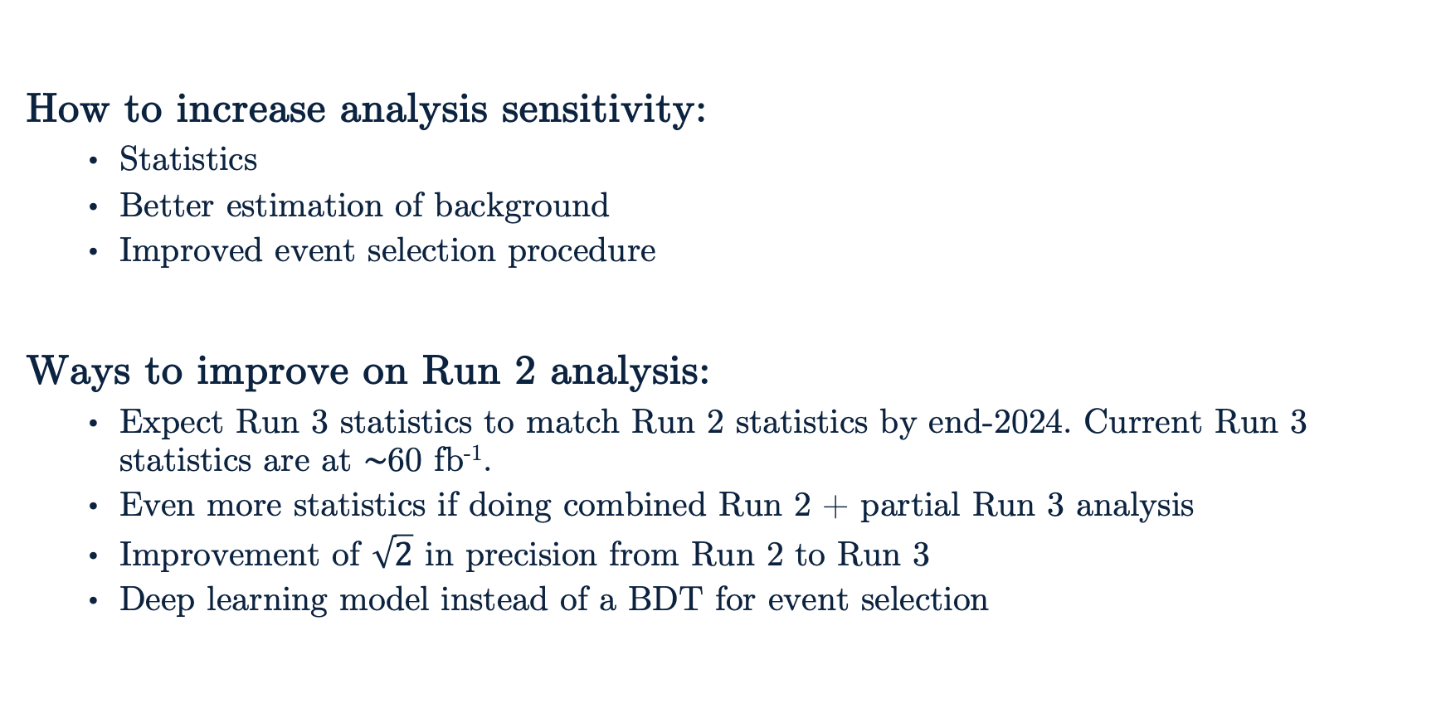
Advancements on Previous Studies
How to increase analysis sensitivity:
Statistics
Better estimation of background
Improved event selection procedure
Ways to improve on Run 2 analysis:
Expect Run 3 statistics to match Run 2 statistics by end-2024. Current Run 3 statistics are at $∼$60 fb⁻¹.
Even more statistics if doing combined Run 2 + partial Run 3 analysis
Improvement of $\sqrt{2}$ in precision from Run 2 to Run 3
Deep learning model instead of a BDT for event selection
Notes:
Need 100k events for deep learning model
Facts about previous analysis:
Run 2 analysis looked at 2016–2018 data
132 fb⁻¹ of raw statistics
Set limits on $σ\left(pp→h\right) × Br(h→aa→γγγγ)$ of 0.80 fb for m_{a} = 15 GeV and 0.26 fb for m_{a} = 62 GeV
Dedicated MC background samples such that requiring 4 photons is less computationally expensive. Would need custom samples though…

Slide 29
The Standard Model and Beyond
LHC, CMS, Technical Contributions
Introduction to Analysis
Sample Generation
Event Selection
Signal Modelling
Advancements on Previous Studies
Summary
Notes:
Introduction – what am I doing? Basic why is it interesting?
The Standard Model and Beyond – theory stuff
LHC and CMS – also mention service work here briefly
Sample Generation – signal MC and event mixing part
Event Selection – cuts, BDT, categorization
Signal Modelling – signal modelling + note on background fits
Advancements on Previous Studies – exactly what it sounds like
Summary – put everything together for questions
REMEMBER TO INCLUDE PLOTS!!!!!!!

Slide 30
Summary
Many of the tools needed to perform the full analysis are constructed:
Event selections processor
Event selection BDT
BDT score category optimization tools
Signal modelling tools for nominal mass points
Future Work:
Fix any problems with current suite of analysis tools
Background modelling
Limit setting in Run 2 proof-of-concept study
Applying work to Run 3 data
Goals:
Complete reproduction of Run 2 analysis for 2018 subset with new analysis framework
Increase analysis sensitivity for Run 3 data and possibly produce a discovery
A search for the SM Higgs boson decaying to two pseudoscalars with a fully resolved, four photon final state was proposed.
Notes:
The background model is built to describe the shape of the mgggg distribution that results from processes other than the signal process. Since the shape of this distribution is not known, different functional forms must be considered in the construction of the background model.
Idea behind choosing a function:
As part of the background modeling procedure, a large set of candidate functions are considered that includes exponentials, Bernstein polynomials, Laurent series, and power law functions. A subset of functions from each family are used to build the background model. For each family, the maximum order of parameters is fixed by means of a likelihood ration test, and the minimum order is determined by applying a requirement on the goodness-of-fit.

Slide 31
Thank You!

Slide 32
Backup

Slide 33
Analysis Overview
nanoAOD Samples
Apply Selections with HiggsDNA
BDT Training
BDT Score Categories
Signal MC
Event Mixed
Background
Data
Low mass diphoton selections
N-dim reweighting of samples for BDT training
Process samples with BDT model
1-dim reweighting of BDT scores
Photon selections
Training event selection BDT
Optimize and cut on categories
x
Background Modelling
Signal Modelling
Next Steps…
Limit Setting
Discovery?
Generate nominal mass point models
Generate models for all mass points
Generate intermediate mass point models

Slide 34
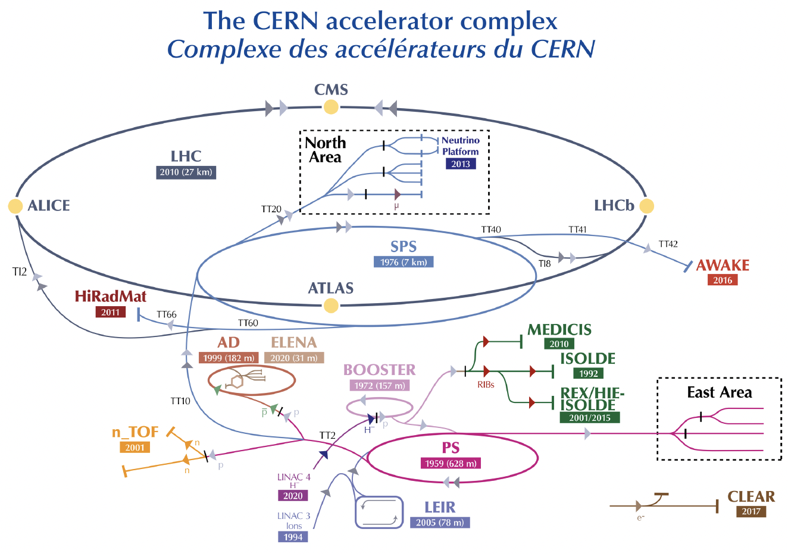
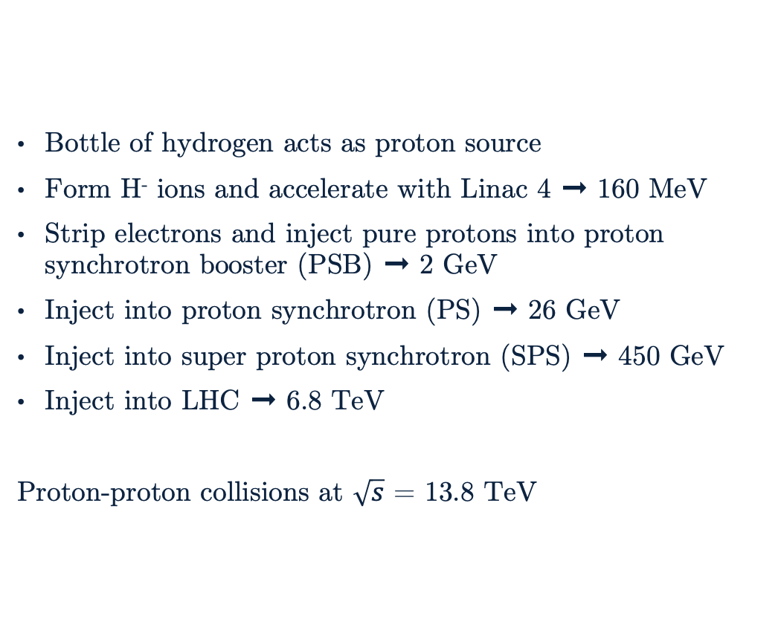
LHC Operations
Bottle of hydrogen acts as proton source
Form H⁻ ions and accelerate with Linac 4 ➞ 160 MeV
Strip electrons and inject pure protons into proton synchrotron booster (PSB) ➞ 2 GeV
Inject into proton synchrotron (PS) ➞ 26 GeV
Inject into super proton synchrotron (SPS) ➞ 450 GeV
Inject into LHC ➞ 6.8 TeV
Proton-proton collisions at $\sqrt{s}$ = 13.8 TeV

Slide 35
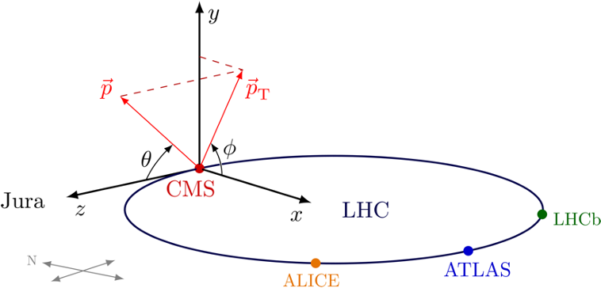



Geometry of CMS
Origin is at collision point.
(x,y) plane is perpendicular to beam axis and x-axis points towards center of ring and y-axis points upwards.
$φ$ is the azimuthal angle.
$θ$ is the angle between the beam axis and (x,y) plane.
Tranverse momentum (p_{T}) and energy (E_{T}) are perpendicular to the beam axis.
Angular Displacement:
where
Notes:
Transverse is anything radially outwards, i.e., transverse to the beam direction, z.
Pseudorapidity is Lorentz invariant under longitudinal boosts (along z).

Slide 36
Object Reconstruction
Particle Flow (PF) Algorithm
Takes raw hits in the detector and creates PF elements
Links PF elements between sub-detectors to create particle candidates
Reconstruct muons
Electrons and isolated photons
Charged/neutral hadrons and non-isolated photons
Combines particle candidates to build a picture of a collision event

Slide 37

Electroweak Symmetry Breaking
Notes:
SU(2) doublet.
Q_L is left handed quarks. d_R is right handed down-type quarks. u_R is right handed up-type quarks. L_L is left handed leptons. e_R is right handed leptons. HC is Hermitian conjugate.
4x4 generators are why e^Xt retains G^0. t2 is (0 1 // -1 0) and yields the G^0 back when multiplying it out.
Unitary gauge allows me to get rid of the exponential.

Slide 38





Higgs Mechanism
Expanding , we get (excluding h mixing terms):
This yields masses for W/Z and the photon:
with mass
Notes:
Excluding h mixing terms from Phi and only considering the vev in the doublet.

Slide 39




Restrictions on Extended Higgs Sector Models
Two main constraints on extended Higgs sector models:
Experimentally $ρ$ = 1
No Flavor Changing Neutral Currents (FCNC) at tree-level ($Z_{2}$ symmetry)
taking .
Restricts values of (T₃, Y) to (0, 0) Singlet
(1/2, 1) Doublet
(3, 4) Septet
…
Notes:
Rho = 1 is an experimental observation but it technically is 1.0004 – something offset slightly.
FCNC is when you change quark flavor without a W boson (hence the neutral).
Any tree-level FCNC contribution from the scalar sector is avoided if each sector of fermions, up, down, and leptons, couples to only one of the doublets. Then the Yukawa couplings of all three neutral Higgs mass eigenstates remain aligned to the fermion mass matrices and are simultaneously diagonalized, e.g. can’t do H/A -> tc but can do H/A -> ccbar
i refers to which multiplet you’re looking at. Higgs doublet has (T_3, Y) of (1/2, 1)
Singlet: one value of T
Doublet: two values of T (+1/2, -1/2)
Septet: seven values of T (3,2,1,0,-1,-2,-3)
…..
Anything not in that list, e.g., triplets, need specially chosen (contrived) VEV for rho $∼=$ 1

Slide 40

Generating Additional Higgs Bosons
Notes:
Complex part of G^0 yields the pseudoscalar boson. CP-odd because charge conjugation operator has a complex conjugate which flips the sign of the field.

Slide 41

Samples Conversion
Relevant data types in CMS:
miniAOD: Uses Event Data Model (EDM) containers and requires CMSSW framework.
nanoAOD: Flat tree that can be read directly with ROOT/Python. Significantly smaller file size.
Converted samples from miniAOD to nanoAOD:
Signal MC
Data
Converting samples required special CMSSW software built by the $h→γγ$ group to include additional branches not usually stored in nanoAOD format.
Notes:
CMSSW is the event

Slide 42

Event Mixing
Expected shuffling:
How to read: Event N has photons from events N, N+1, N+2, N+3.
Alternate notations:
Photon # (belongs to Event #)
Photon 1 (Event 1) → Photon 1 (Event 1)
Photon 2 (Event 1) → Photon 2 (Event 2)
Photon 3 (Event 1) → Photon 3 (Event 3)
Photon 4 (Event 1) → Photon 4 (Event 4)
And so on for the other events…
Photons shifted to Event 1
Event 1 (Event 1) → Photon 1 (Event 1)
Event 2 (Event 2) → Photon 2 (Event 1)
Event 3 (Event 3) → Photon 3 (Event 1)
Event 4 (Event 4) → Photon 4 (Event 1)
Notes:
Shuffles photons such that any presence of signal is removed from the data. Would expect a signal event to have pairs of photons that form pseudoscalar candidates with the correct mass. This prohibits that and makes it “random”.

Slide 43



Higgs to Diphoton NanoAOD Framework (HiggsDNA)
Python-based analysis framework for processing flat tree nanoAOD files.
Event Based Columnar Based
Utilizes Coffea processors which provide an efficient backend that allows one to focus on the selections an analysis at hands.
HiggsDNA was built for the $h→γγ$ group for the standard analysis.
A complete framework is being developed, including methods to implement systematics, corrections, and streamlined object selections.
Notes:
Python-based framework for processing flat tree nanoAOD files. It’s part of the move towards using nanoAOD and replaces the old framework, Flashgg, which processed miniAOD files using CMSSW. (see other backup if necessary)
Columnar: do operations to all events at once rather than per-event. Faster to implement usually (Python).
Columnar is faster in the modern implementation using Python. This also works very well with the smaller data sizes (nanoAOD) that CMS now uses.
Coffea backend is incredibly efficient and accesses the ROOT file and events list for you. Enable quick start into analysis.
Systematics adds variation to events, corrections make MC closer to data, and object selections is easier access to leptons, jets, muons, etc. In current HiggsDNA selections folder.

Slide 44


Pre-selections
$γ_{1}$ must be: | E_{T} | R₉ | H/E | $$σ_{iηiη}$$ | PF Pho Iso | Tracker Iso
EB; R₉ $>$ 0.85 | 15.0 | $>$ 0.5 | $<$ 0.08 | $<$ 0.015 | $<$ 4.0 | $<$ 6.0
EB; R₉ $≤$ 0.85
EE; R₉ $>$ 0.9 |  |  |  | $<$ 0.035
Selections slightly more strict than High Level Trigger (HLT) are applied
Events must pass at least one of Options 1-3 (motivated by miniAOD cuts)
Photons must also pass an electron veto
Events must have at least two photon candidates
Diphoton candidates require p_{T} > 30 GeV and p_{T} > 18 GeV for leading and subleading daughter photons
Option 1 | Option 2 | Option 3
R₉ $>$ 0.8 | Charged Hadron Iso $<$ 20.0 | Charged Hadron Iso/p_{T} $<$ 0.3
 |  | IF p_{T} $>$ 14.0
 |  | AND H/E $<$ 0.15
Notes:
Important to note why each variable is used as a cut. Not important to mention the values beyond resolution(?) of photons below 15 GeV
ON A HIGHER LEVEL (NOT ABOUT CANDIDATES):
HLT cuts are applied such that simulation and data align
Options 1-3 mimic cuts for miniAOD

Slide 45


Deep learning vs BDT
BDT models are easier to create and faster to train but are prone to overtraining.
Deep learning models outperform BDT models with $∼$100k events.
Better with lower-level variables as to build more complex networks
Deep learning removes some of the data preparation required before training a model (e.g. choosing which variables to train with).
Notes:
100k events required to make deep learning worth it.
BDT are way easier but can be outperformed with larger training sets.
Deep learning might remove some of the questions about which variables should we train the BDT with.

Slide 46

Event Selection BDT – m_{Hyp}
One event selection BDT model is produced for all mass points, made possible by using a constructed variable: hypothesis mass or m_{Hyp}
m_{Hyp} has the associated value for a given pseudoscalar mass point for signal MC but a flat distribution for event mixed background and data, by construction.

Slide 47


Event Selection BDT Inputs
Processed signal MC samples are combined into one signal-like sample. Processed event mixed background is used as the background-like sample.
An N-dim reweighting is performed to correct discrepancies between event mixed background and data before training.
Input variables:
$γ_{1,2,3,4}$ MVA ID
a₁ p_{T} a₂ p_{T}
ΔR(a₁,a₂)/$m_{γγγγ}$
m_{a1} – m_{a2}
cos($θ_{aγ}$), where $θ_{aγ}$ is the angle between the leading photon coming from the leading pseudoscalar and the direction of $a→γγ$
$\frac{m_{a1 RECO}−m_{a Hyp}}{m_{γγγγ}}$ $\frac{m_{a2 RECO}−m_{a Hyp}}{m_{γγγγ}}$
Above: Chart of feature importance for the event selection BDT input variables from one of the best performing models.

Slide 48


Important BDT Input Variables
Left: Distribution of ($m_{a2 RECO}−m_{a Hyp}$)/$m_{γγγγ}$ for subleading pseudoscalar candidate. Shown for signal MC at 15, 30, 40, 60 GeV pseudoscalar mass points, event mixed background, and data. All selections have been applied.
Above: Chart of feature importance for the event selection BDT input variables from one of the best performing models.

Slide 49


Training the Event Selection BDT
A 1-dim reweighting of BDT score is required for each pseudoscalar mass point after training the event selection model.
Training/testing is split amongst odd/even events and is performed over the full $m_{γγγγ}$ mass range.
Samples are weighted by the appropriate luminosity and the per-event N-dim reweights before training.
Above: Event selection BDT predictions for training set using processed signal MC and event mixed background.

Slide 50


Checking the Event Selection BDT
Checks for overtraining are done to ensure an optimal event selection model is produced.
Early stopping using training and testing sets is done to reduce overtraining.
m_{a} = 15 GeV
Notes:
Efficiencies curve for one of the best event selection BDT models. A match between train/test curves and their associated area under curve (AUC) indicates a lack of overtraining.
Overtraining check by comparing prediction distribution of trained event selection BDT model for m_{a} = 15 GeV. Odd/even (train/test) samples should have a similar distribution which would indicate a lack of overtraining.
Efficiency checks can be done for the entire model at once and even/odd checks must be done by nominal mass point.
Early stopping stops the training if no significant improvement in the training metric has been shown after a certain number of epochs (i..e, training rounds).
Cross-validation is something I plan to do which can help reduce overtraining even more – if it ends up being necessary.

Slide 51

BDT Score Categorization Extra Details
Reminder: Approximate Mean Significance (AMS) is defined as
where S and B reference to the number of signal and background events, respectively.
The BDT score distributions for signal MC, event mixed background, and data are smoothed for each nominal mass point to account for statistical fluctuations when using very fine binning.
Categories are constructed to maximize AMS in the signal region, where events with BDT scores inside the boundary are kept. Only one category is created.
Cuts on the category boundary are applied on top of all analysis selections for all samples.
Category boundaries are optimized to maximize total AMS in the signal region while requiring at least 8 data events in the sideband region.
Sideband
Signal Region
Notes:
Quantify signal/background-like BDT by using categories. Categories are made to optimize AMS. Events with BDT scores inside category boundaries are kept and those outside are removed.
Need to choose what BDT score is signal-like enough. Categories are used to determine what BDT score is enough to classify an event as signal.
Categories are constructed to maximize AMS in the signal region, where events with BDT scores inside the boundary are kept. Only one category is created.
Cuts on the category boundary are applied on top of all analysis selections for all samples.
A minimum of 8 data events in sideband region are required for optimal background estimation and data fitting.
Signal Region: $115<m_{γγγγ}<135$ GeV
Sideband Region: $(110<m_{γγγγ}<115)∪(135<m_{γγγγ}<180)$ GeV

Slide 52



Fitting Signal Shape
Order of Gaussians to fit signal shape is determined by likelihood ratio test
Optimal order when
where is the Negative Log Likelihood for N Gaussians.
NLL is computed by RooFit’s minNll and the integral by RooFit’s Prob.
follows a $χ^{2}$ distribution with M degrees of freedom, where M is the difference in degrees of freedom between N and N+1 Gaussians.
The optimal order is found to be 2 Gaussians for all nominal pseudoscalar mass points.
Notes:
M = 3 (2N total + N-1 for normalization → 2 Gaussian = 5-2 = 3 dof)

Slide 53







Analysis Significance
Reminder: Define significance as Z₀ and AMS by
Choose to use AMS instead of ubiquitous $s/\sqrt{b}$ since s$≪$b does not hold!
Can extract $s/\sqrt{b}$ from AMS if s$≪$b:
Take significance defined in terms of the likelihood test statistic:
Assume nominal signal hypothesis ($\hat{μ}$ = 1), i.e., n ➞ s + b. Yields AMS.
Expanding logarithm in $s/b$ yields .
It is very clear that AMS is a much better estimation of significance than $s/\sqrt{b}$ when s$≪$b does not hold.
Notes:
It’s not just that AMS is inherently “better” in general. It’s the only valid choice for our case where s $∼$ b (due to low statistics of all processes). Plot shows how AMS is a much better estimation of significance (Z_0) than s/sqrt(b) when s is s and b are similar in size.
Plot taken from DOI 10.1140/epjc/s10052-011-1554-0.

Slide 54



Miscellaneous
E_{T} and p_{T}:
For massless particles, E_{T} = p_{T}.
Vacuum of LHC: 10⁻¹⁰ mbar
Notes:
Why cosh? Because of the definition of pseudorapidity and I’m not well versed enough to derive that on the fly.
Higgs production cross section for all channels combined is 52 pb.

